Slide 1
Hall D Online Integration
Hall D System Review
Elliott Wolin
Jefferson Lab
7-May-2008

Slide 2
Outline
Introduction and Overview
Trigger and DAQ
Networking
Controls
Monitoring
Software and Computers
Future Outlook
Summary and Conclusions

Slide 3
1. Introduction and Overview
Online tasks include:
  trigger
  DAQ
  controls
  monitoring
Rely heavily on work of:
  JLab Electronics group
  JLAB DAQ group
  other Hall D groups

Slide 4
Scope:
  20,000 FADC, 5000 TDC, misc other channels
  700 DAQ boards in 50 readout crates
  HV, LV, other crates
  600 hardware control points
  29,000 electronics control points
  hundreds of monitoring histograms
  databases (controls archive, bookkeeping)
  electronic logbook system
  computers, networking, telecom
  operator and counting house environment

Slide 5
Trigger and Data Rates
 | Low Luminosity | High Luminosity
L1 trigger rate | 20 kHz | 200 kHz
Average event size | 15 kB | 15kB
Date rate off detector | 300 MB/s | 3 GB/s
L3 rejection | None | Factor 10
Rate to storage | 300 MB/s | 300 MB/s

Slide 6
Online Safety:
  no unusual safety issues specific to online
  HV, LV, crates commercial devices
  use licensed electricians, trained technicians
  JLab standard safety procedures followed
  two operators on shift when running
Control system is part of detector safety system
  does NOT provide ultimate hardware protection
  all devices fail-safe against failure of control system
  detectors reviewed separately

Slide 7
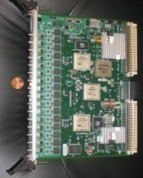
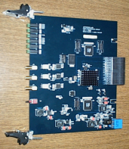
2. Level 1 Energy Sum Trigger
-Fiber links-
12 Crates
FADC
CTP
BCAL SUM
SSP
ENERGY SUM
(8 INPUTS)
GTP
Select FCAL Energy,
BCAL
Energy,
Photon
Energy,
AND
Hit Counts
<,>,=
TRIGGER
SUPERVISOR
-----------------
CLOCK
TRIGGER
SYNC
ROC
CONTROL
-VXS-
-Fiber links-
12 Crates
CTP
FCAL SUM
SSP
ENERGY SUM
(8 INPUTS)
FADC
-VXS-
START COUNTER
HIT COUNT
-Fiber link-
1 Crates
SSP
HIT COUNT
(8 INPUTS)
FADC
-VXS-
-Fiber links-
2 Crates
TOF HIT COUNT
SSP
HIT COUNT
(8 INPUTS)
FADC
-VXS-
-Fiber links-
2 Crates
* Longest Link *
TAGGER ENERGY
SSP
PHOTON E
(8 INPUTS)
FADC
-VXS-
Signal distribution to Front End Crates (Fiber Links)

Slide 8
Full Experiment Trigger
Trigger Signal
Level 1
Energy Sum
Trigger
16 bits
T
r
igger
Inputs
Detector
O
u
t
p
u
t
Pulser 1
Pulser n
Add’l
Trigger
Logic
16 bits
Calib 1
Calib n
Trigger
Supervisor
Module

Slide 9
300 MB/s
300 MB/s
DAQ at Low Luminosity
300 MByte/sec
300 MB/s
ROC
E
MU
E
MU
ROC
16 TB
16 hrs
300 MB/s
300 MB/s
ROC
E
MU
E
MU
RAID
Monitoring
Farm
No Rejection
E
MU
ROC
1
EMU
ROC
E
MU
E
MU
300 MB/s
ROC
SILO in Computer Center
2 PB/year
6
EMUs
6
EMUs
12
Monitoring
Nodes
50
ROCs
Event Builder
Crossbar

Slide 10
Online trigger/DAQ tasks:
  overall design
  implementation of CODA3 for Hall D
  configuration of all hardware and software
  experiment-specific programming front end ROCs
  custom data handling along DAQ chain
  monitoring farm (w/Offline group)
    L3 trigger in full farm (w/Offline group)
  integrating slow controls and run control
    Experiment Control
  transferring physics data (EVIO format) from RAID to silo
  management of monitoring/controls archive databases
  all computers and networking equipment
  commissioning entire trigger and readout chain
  monitoring, error detection, initial diagnosis of problems

Slide 11
3. Networking
For all DAQ data transfer, controls and monitoring communications
Large Cisco switch located in counting house
  can add modules as needed
Multiple (virtual) subnets (DAQ, controls, office, etc.)
Many programmable switches in hall
  fiber connections from counting house to hall
Terminal servers for single board computers
  RS232
At low luminosity worst-case crate data rate < 20 MB/s
  1 GBit Ethernet > 100 MB/s
  VXS backplane > 200 MB/s
  can always split crate if bandwidth problem

Slide 12
Hall D
Networking
JLab Backbone Switch
in Utility Room
10 Gbit links or faster
Hall D Cisco Switch
in Counting House
trunked Gbit or 10 Gbit
Gbit links
Gbit links
DAQ
Controls
Office
Video
Web
others
Hall D Subnets
Fiber connections to hall, copper within hall and within counting house

Slide 13
Networking Hardware
Device | Count
Cisco main switch | 1
Satellite switches | 10
Terminal servers | 5
Wireless access points | 6
Everything is commodity hardware, available today

Slide 14
4. Controls/Monitoring Channel Counts
Type | Number of Devices | Control Points per Device | Channel Count | Control Mechanism
FDC cooling system | 20 | 1 | 20 | PLC
Cryogenic target | 40 | 1 | 40 | PLC
Solenoid magnet | 200 | 1 | 200 | PLC
Gas systems | 40 | 1 | 40 | PLC
Misc | 50 | 1 | 50 | PLC
Tagger/beamline | 200 | 1 | 200 | Ethernet
Goniometer | 6 axes | 10 | 60 | Ethernet
VXS, VME, HV, LV crates | 80 | 15 | 1200 | OPC
HV, LV channels | 2300 | 4 | 9200 | OPC
Discriminators | 2800 | 1 | 2800 | Ethernet
Cockroft-Walton bases | 2800 | 5 | 14000 | CAN
Board temperatures | 1575 | 1 | 1575 | I2C
Misc | 200 | 1 | 200 | Ethernet
Software Channels | 200 | 1 | 200 | Ethernet
TOTAL |  |  | 29785
These are typical control/monitoring channel counts for experiments this size

Slide 15
Controls Strategy
Traditionally, run control and slow controls separate
Want run control to be sensitive to detector state
→ unified strategy: “Experiment Controls” ←
  integrate slow controls and DAQ run control
    e.g. HV system becomes a DAQ component
    e.g. cannot turn off LV if run in progress
  all systems must communicate with each other
  extensive use of state machines
Three-tier controls architecture
  common at LHC

Slide 16
Traditional Run Control
Run Control State Machine
OK
Start Run?
OK
Check ROCs
Check EBs
Check Farm
Check ER
GO
Operators must check slow controls system beforehand!
Problem
Run Control and Slow Controls are separated!
FIX

Slide 17
Integrated Experiment Control System
Experiment Control State Machine
OK
Start Run?
OK
Check ROCs
Check EBs
Check Farm
Check ER
Check Controls
GO
Controls State Machine
Check HV
Check LV
Check gas
Check …
check …
check …
Problem
check …
check …
FIX
Key is integration of Run Control and Slow Controls State Machines

Slide 18
Hall D 3-Tier Controls Architecture
Experiment Control System
(ECS)
High-level state machines and operator GUI’s.
(AFECS)
Supervisory Control and Data Acquisition System
(SCADA)
Communication, archiving, alarms
(EPICS)
Autonomous detector control, low-level state machines.
(PLC, Ethernet, OPC, CAN, I2C)
Detector Control System
(DCS)
Allen-Bradley
PLC
HV
System
LV
System
Other
Systems
Solenoid
Target
Gas
Cooling

Slide 19
Detector Control System
  24x7 autonomous operation
  part of overall safety system
  all PID and control loops reside here
  Allen-Bradley PLC
    prefer simple analog sensors/actuators
  High-level manufacturer-supplied controllers
    HV, LV
    goniometer
    CAN, I2C controllers

Slide 20
SCADA (Supervisory Control and Data Acquisition)
  EPICS (Experimental Physics and Industrial Control System)
    JLab has extensive experience with EPICS
      accelerator control based on EPICS
      all three halls use EPICS
      can read each other’s controls information
      active collaboration, many new developments
    will use Linux-only EPICS, no VxWorks
    Control System Studio (CSS) for graphics
    Channel Access (CA) foundation for communications
    alarm system
    many other tools in EPICS toolkit
      archiver
      stripchart tool
      save-and-restore facility

Slide 21
Experiment Control System
  AFECS
    Agent Framework for Experiment Control Systems
    Java agent-based control system from JLab DAQ group
    used for CODA3 run control
    allows integration of slow controls with run control
      high-level state machine scripting language
      hierarchical
      similar to SMI++ used at LHC

Slide 22
Ethernet
Allen-Bradley
PLC
Linux Computers
Counting House
Hall D
Allen-Bradley
Control-Net
Tar
get
Target Control Crate
FDC
HV Crate
Allen-Bradley
Control-Net
Magnet
Solenoid Control Crate
GONI
Goniomenter Control
Control Network Configuration

Slide 23
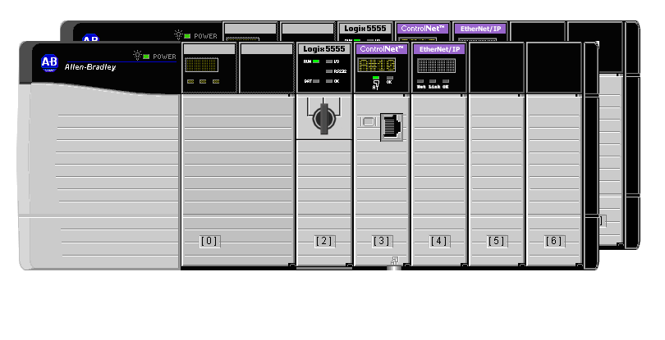
PLC Redundant Chassis Layout
Seven Module Chassis
PLC
Communication
Module
Power supply
Redundancy
Module
Remote Chassis
Communicator
Blank Slots
Notes:
Redundant Chasis

Slide 24
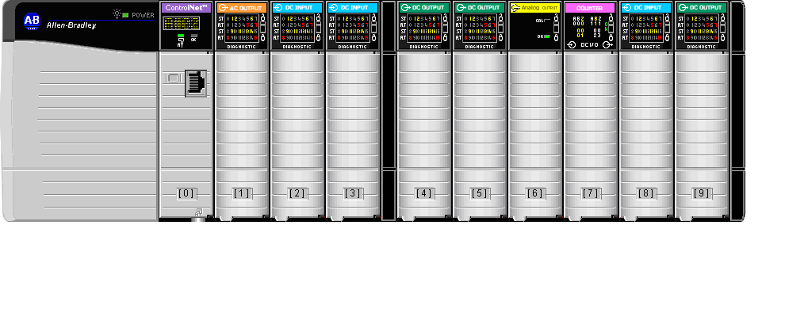
Ten Module Remote Chassis
Field Devices:
  temperature sensors
  pressure gauges
  vacuum gauges
  cryogenic level gauges
  relays
  voltage, current gauges
  flow meters
  many others
Power supply
DC Input Module
Remote Chassis
Communicator
Notes:
Rotation Chasis

Slide 25
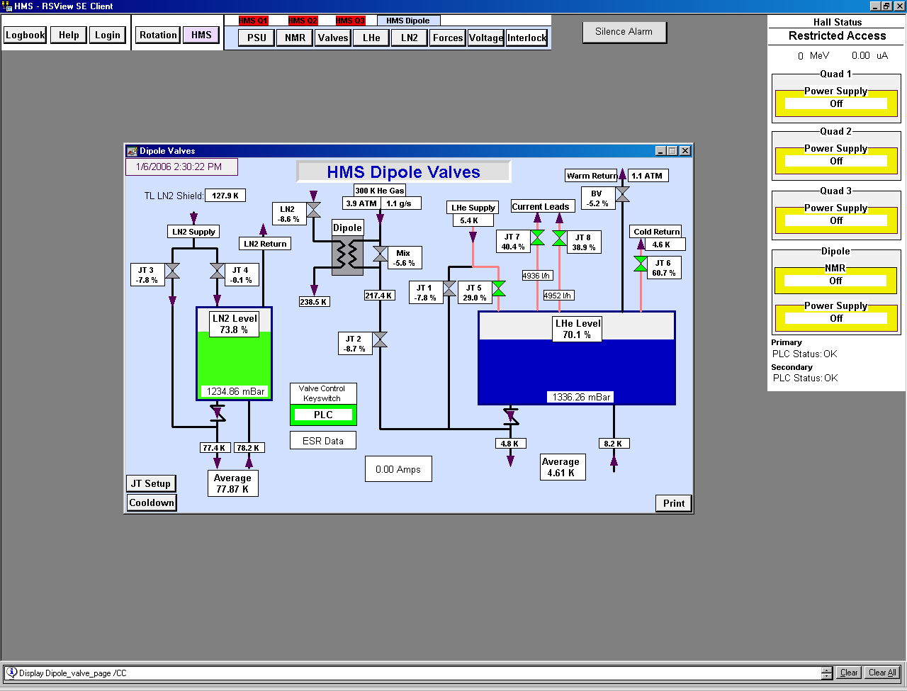
Human Machine Interface (HMI)
RSVIEW & RS-Studio
Notes:
Dipole Valve Page

Slide 26
Alarm System
Goals
  All alarms require operator action
    otherwise “alarm” is a nuisance
  Single problem gives single alarm
    alarm filtering
  Context sensitive alarms
    no alarm on device if not being used
  Alarm shelving
    remove from alarm screen
Will use EPICS alarm system
  alarm state machines

Slide 27
5. Monitoring
Scope
  detector and electronics health and performance
  data quality
  hall infrastructure and environment
  computer and networking systems
  accelerator performance
  computer center
Time scales vary tremendously
  from seconds to hours!

Slide 28
Types of information to be monitored
  from DAQ
    physics triggers, in monitoring farm
    non-physics triggers
      sync events
      calibration events
    other data in data stream
      scaler data
      component performance information
  controls system information
  video
  web info

Slide 29
Audiences
  shift personnel
    full, broad spectrum of tools, in counting house
    rapid response
    uniform look-and-feel
    expert screens, with guidance
  detector experts
    specialized tools
    uniform look-and-feel not as important
    available from off-site
  accelerator operators
    subset of Hall D operating parameters
  management
    overall experiment performance

Slide 30
Monitoring Tools
  event analyzer in monitoring farm
    partial reconstruction of physics events
    ROOT-based histograms (occupancy, etc.)
    can generate alarms
  other programs analyze non-physics data in DAQ stream
  archiver
    controls and monitoring information
    EPICS utility, uses relational database
    web-based viewer
  event display
    essential!
    live events from data stream or from file
  electronic logbook
    extensive searching and cross-indexing
    problem tracker/resolution facility
    automatically notifies experts of problems

Slide 31
6. Software and Computers
Although we:
Rely on JLab DAQ group for a lot of software
Use EPICS toolkit
Rely on standards as much as possible
Still:
A lot of custom software needed for integration
Expect order of 100K lines-of-code needed
Manpower is allocated for this
This is a typical amount of code for experiment this size

Slide 32
Computer Equipment in Hall D
Hardware Type | Count
Single-board computers in front-end crates | 70
Event builder nodes | 12
Farm nodes (monitoring farm) | 12
Farm nodes (full L3 farm, after upgrade) | ~50
Event recorder node | 1
RAID system (16 TBytes) | 1
File server | 1
Experiment Control System servers | 5
Other controls servers | 10
Misc desktops, laptops | 15
Allen-Bradley PLC | 1

Slide 33
Maintenance
  rapid response contracts for critical items
    RAID, fileserver, network switch, main UPS
  redundancy/spares for others
    ROCs, event builders/recorder, farm nodes
    can operate with reduced capacity

Slide 34
7. Future Outlook
Rapidly changing field, constant new developments
Our choices meet requirements for Hall D operation
Are carefully monitoring developments:
  multi-core computers
  faster network hardware
  improved utilities
  minimize number of buses and protocols if possible
Change of plans requires evaluation of available time, manpower, money!

Slide 35
8. Summary and Conclusions
Typical requirements for experiment this size
  about same number of readout, controls, and monitoring channels
Three-tier controls architecture
  allows integration of all control functions
Rely heavily on other groups, standards
  minimize amount of custom software needed
  need to develop about 100k LOC
Actively keeping track of new developments
  depending on available resources
Minimize protocols, buses, packages, standards
  simpler
  less manpower

Slide 36
Backup

Slide 37
Field Devices
Temperature Sensors
Magnetic field measurements
Pressure gauges
Vacuum gauges
Cryogenic Liquid Level Meters
RS232/ RS434, etc
Relays
Voltage Taps
Current measurements
Strain gauges
Motor drivers (DC & AC)
LVDT & position indicators
Flow Measurements
Encoders

Slide 38
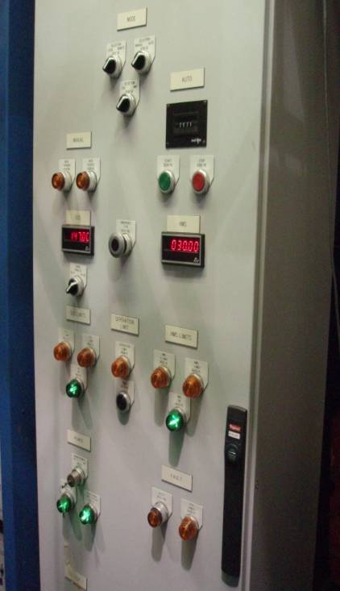
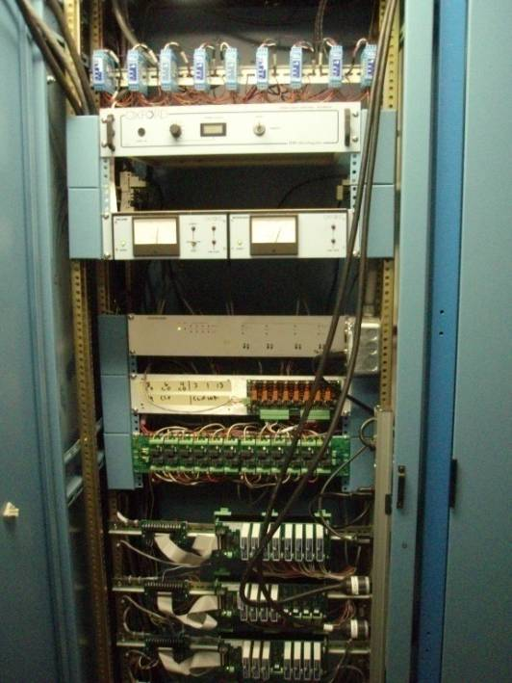
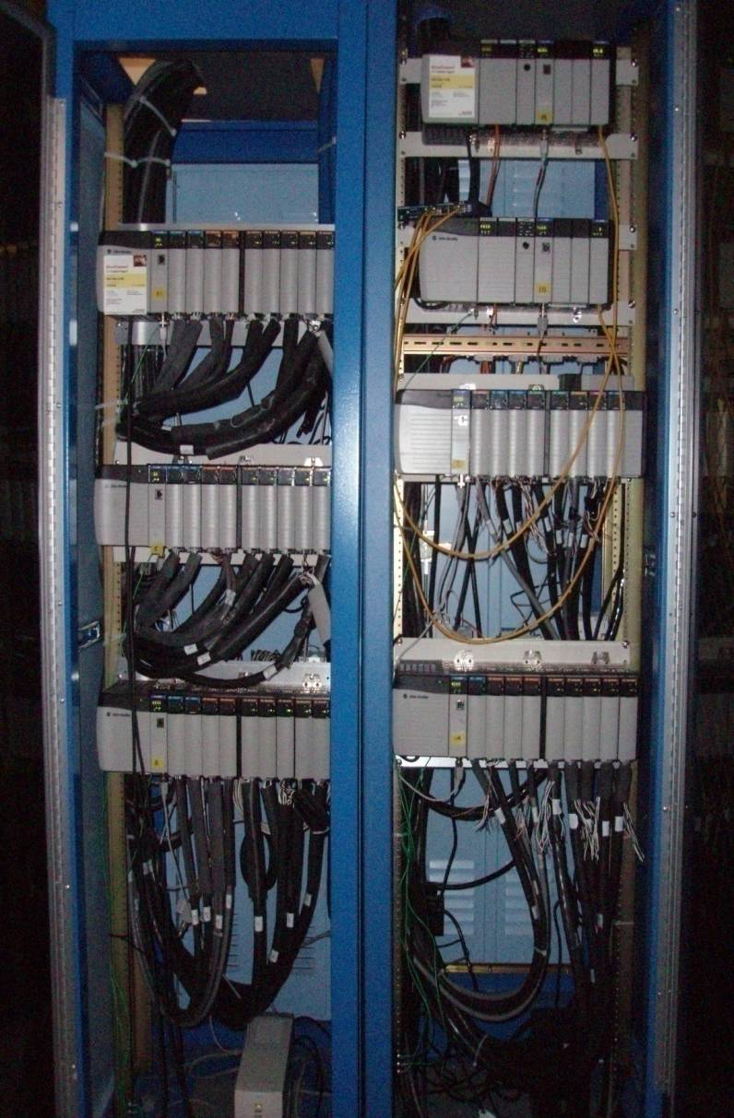
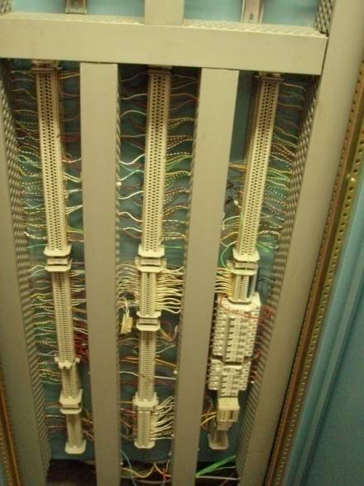
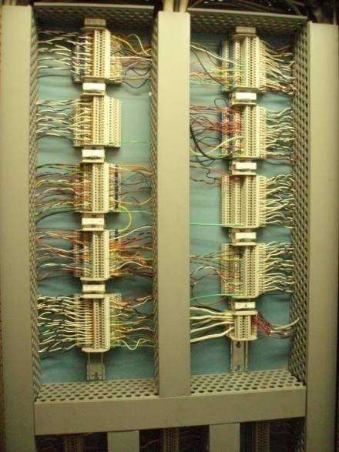
Cabling and Racks
PLC Rack
Local Control Rack / Signal Conditioning

Slide 39
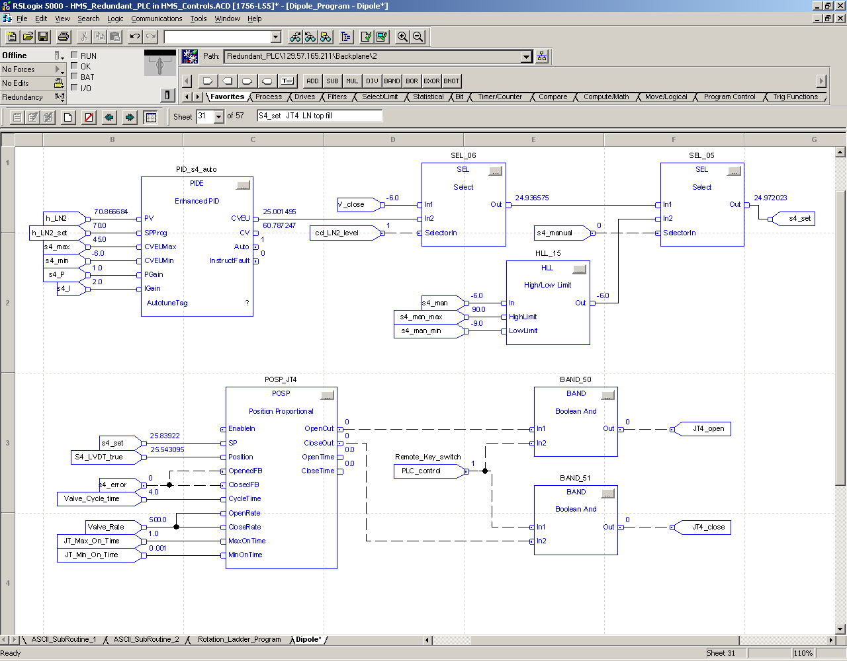
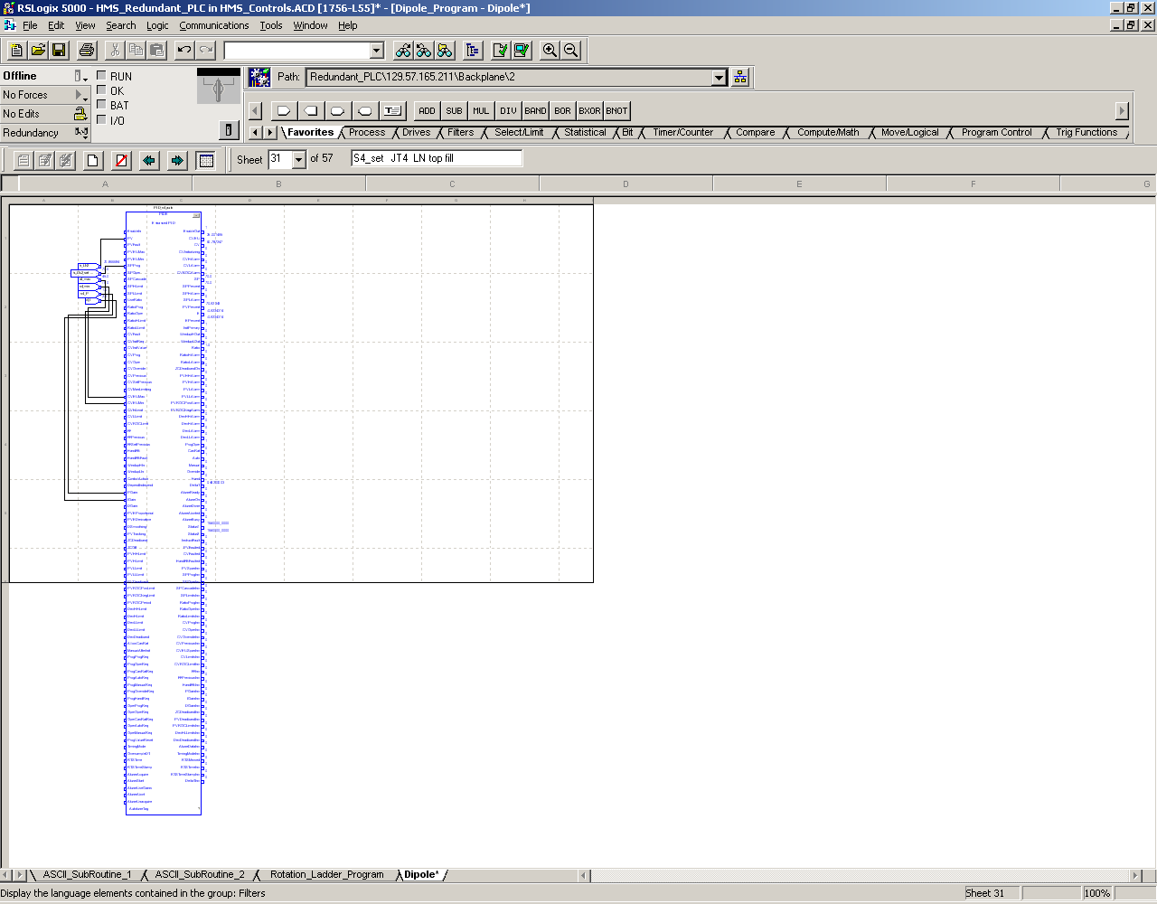
Function Block Program
One PID Function block can have over 160 parameters in it.
Notes:
Complex Function blocks have multiple command embedded in them.

Slide 40
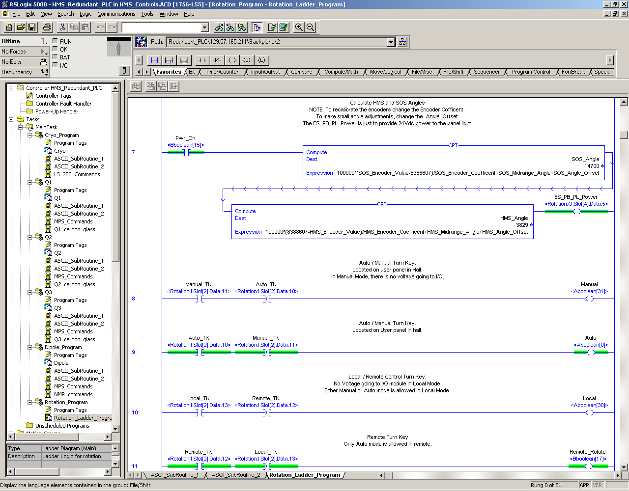
Ladder Logic Program
Notes:
Simple Relay type representation. Can perform complex math functions.

