Slide 1

Accessing the Tunnel/Halls
Notes:
There are a series of requirements that must be met before one can access the Tunnel. Individuals must have reviewed, and electronically signed, the General Access Radiation Work Permit, R, W P, which is available on-line. And they must be carrying either their Personal Dosimeter, or an S R P D, Supplemental Reeding Pocket Dosimeter; though this is not necessary if they have an escort who is carrying one.
Comfortable shoes without open toes, and clothing suitable for their work, are also a must.
In addition, the Machine must be in either Restricted or Controlled Access state. In Restricted Access, qualified personnel can come and go at will, through the Controlled Access points, or unlocked Exit Stair doors. In Controlled Access, qualified personnel can only access the tunnel through the Controlled Access points, and with assistance from Machine Control Center personnel.

Slide 2
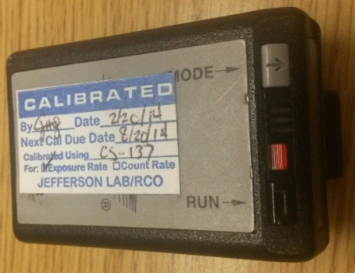
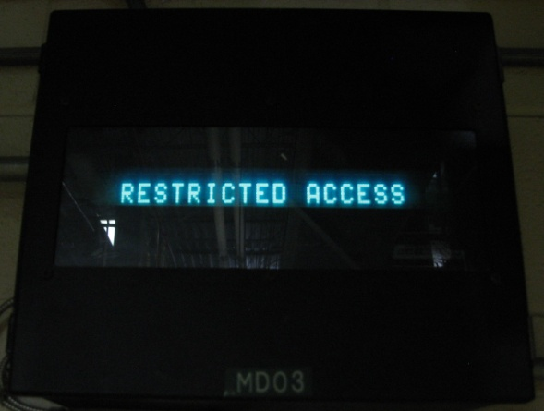
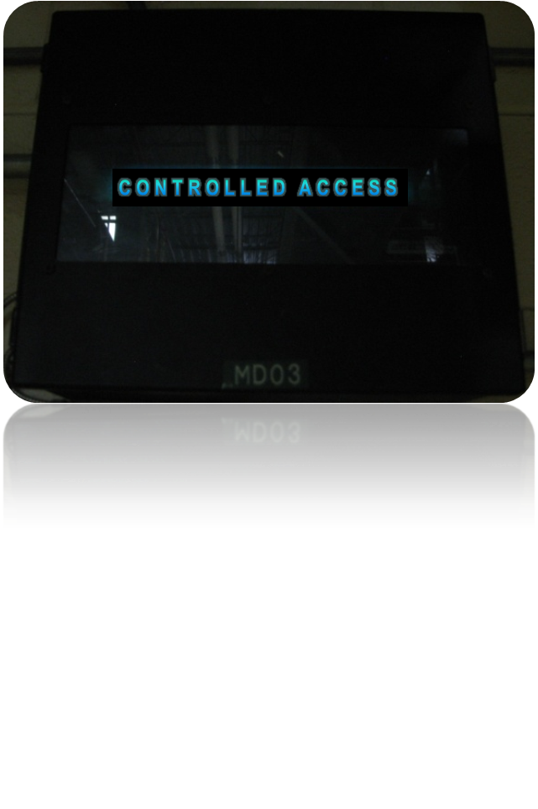
Accessing the Tunnel/Halls
Personnel
  Sign General Access RWP
  Have Personal Dosimeter, or Supplemental Reading Pocket Dosimeter (SRPD*), or escort with SRPD*
  Wear suitable shoes and clothing
Machine
  State needs to be Restricted or Controlled Access
    Restricted Access: Use Controlled Access points or unlocked Exit Stair doors
    Controlled Access : Use Controlled Access points with help from MCC
* SPRD issued by RadCon Division or through Public Affairs Office
Notes:
There are a series of requirements that must be met before one can access the Tunnel. Individuals must have reviewed, and electronically signed, the General Access Radiation Work Permit, R, W P, which is available on-line. And they must be carrying either their Personal Dosimeter, or an S R P D, Supplemental Reeding Pocket Dosimeter; though this is not necessary if they have an escort who is carrying one.
Comfortable shoes without open toes, and clothing suitable for their work, are also a must.
In addition, the Machine must be in either Restricted or Controlled Access state. In Restricted Access, qualified personnel can come and go at will, through the Controlled Access points, or unlocked Exit Stair doors. In Controlled Access, qualified personnel can only access the tunnel through the Controlled Access points, and with assistance from Machine Control Center personnel.

Slide 3
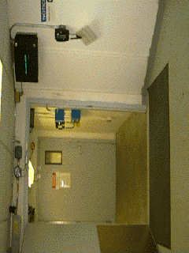
Personnel Access System
Notes:
Personnel Access areas all have a message display, Magnetic lock, and access key bank.

Slide 4
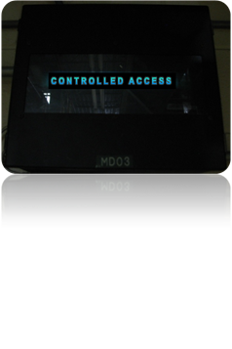
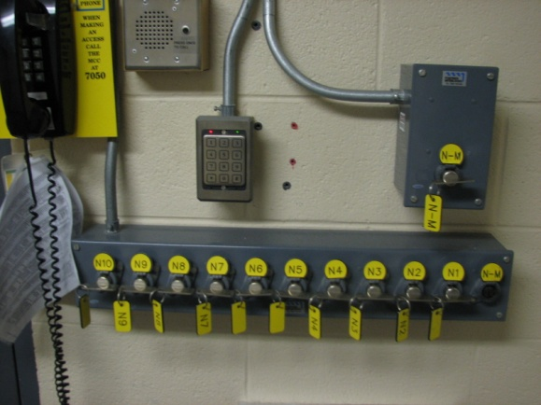
Personnel Access System
Message Display
Magnetic Lock
Access Key Bank
Notes:
Personnel Access areas all have a message display, Magnetic lock, and access key bank.

Slide 5
Accessing the Tunnel/Halls
Check Status Display Screen for Restricted Access or Controlled Access
Notes:
To exit the tunnel during a controlled access, you must use the same door you used to enter. During a controlled access, no other exit doors can be opened, unless there is an emergency.

Slide 6
Accessing the Tunnel/Halls
Check Status Display Screen for Restricted Access or Controlled Access
If Restricted Access, open the door and proceed in
If Controlled Access,
  Contact the Safety System Operator (SSO) at ex.7050 and request the outer door be unlocked
  Once inside the Access Room, call the SSO again to verify OSL and ODH requirements and to have them release the Master Key
Notes:
To exit the tunnel during a controlled access, you must use the same door you used to enter. During a controlled access, no other exit doors can be opened, unless there is an emergency.

Slide 7

Using the PSS
Notes:
When you hear the release “Buzz,” remove the Master Key from the Master Key Box, and place the key in the Master Key Slot. Take an Exchange Key. Spell your name slowly to the S S O and say which Exchange Key you have taken..
You may proceed when the S S O releases the inner door lock.

Slide 8
Using the PSS
Master Key Box
Exchange Key #
Master Key Slot
10 Exchange Keys
Notes:
When you hear the release “Buzz,” remove the Master Key from the Master Key Box, and place the key in the Master Key Slot. Take an Exchange Key. Spell your name slowly to the S S O and say which Exchange Key you have taken..
You may proceed when the S S O releases the inner door lock.

