Slide 1
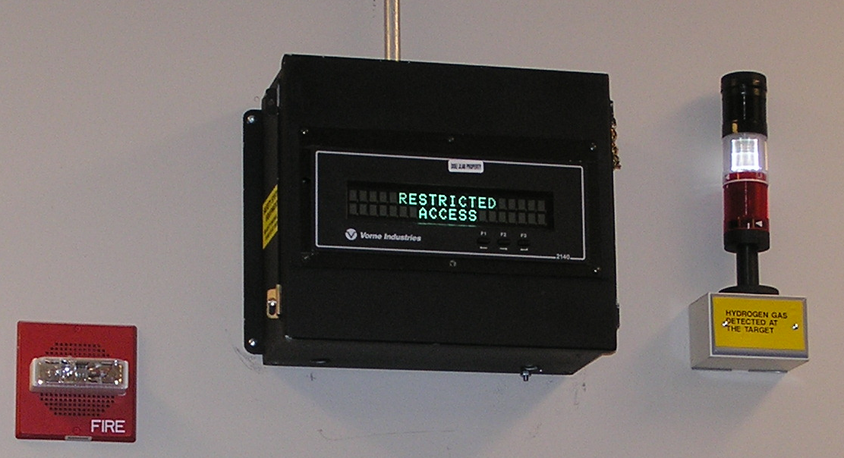
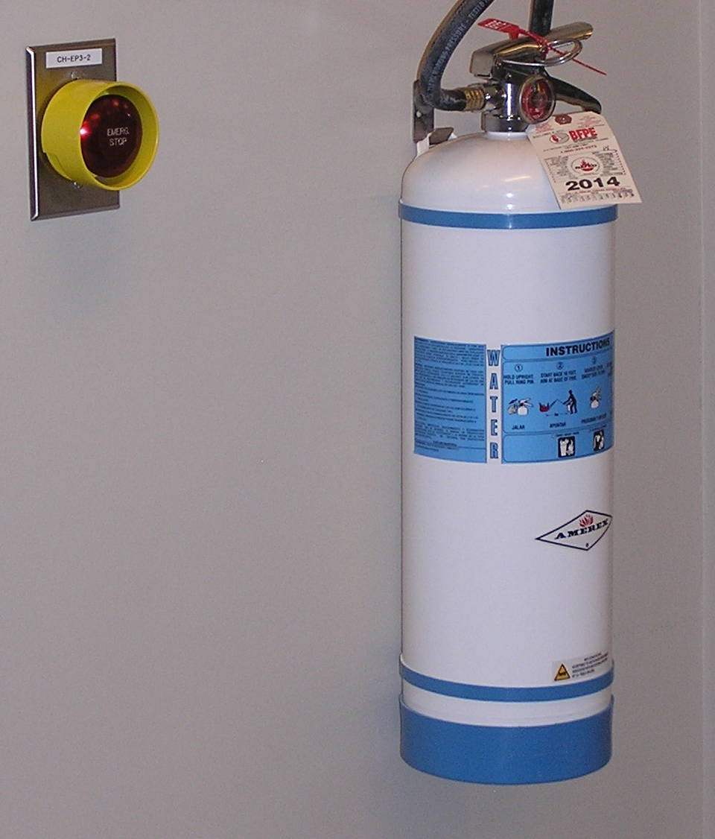
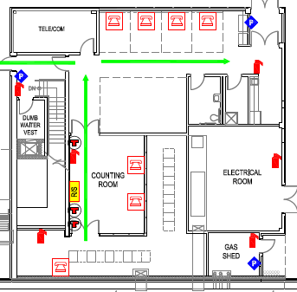
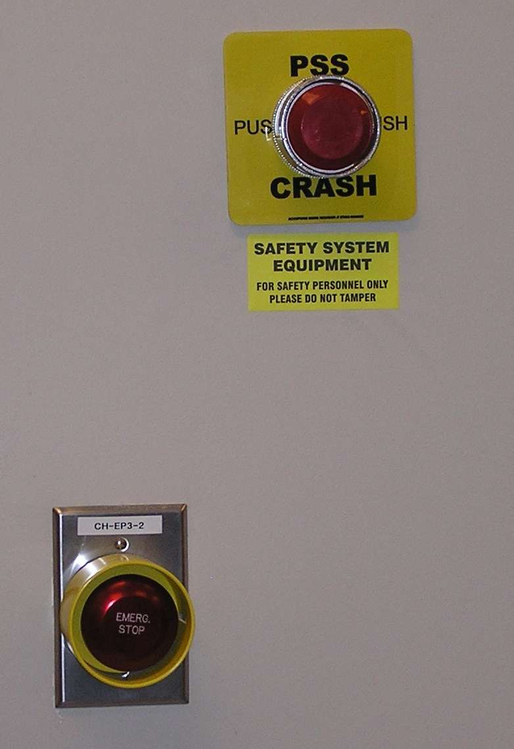
Counting Room
Fire alarm
Power kill button
Beam status
Flammable gas alarm in Hall D
Fire extinguisher
Beam crash button
Power kill button
Both kill buttons trip all power in Counting Room

Slide 2
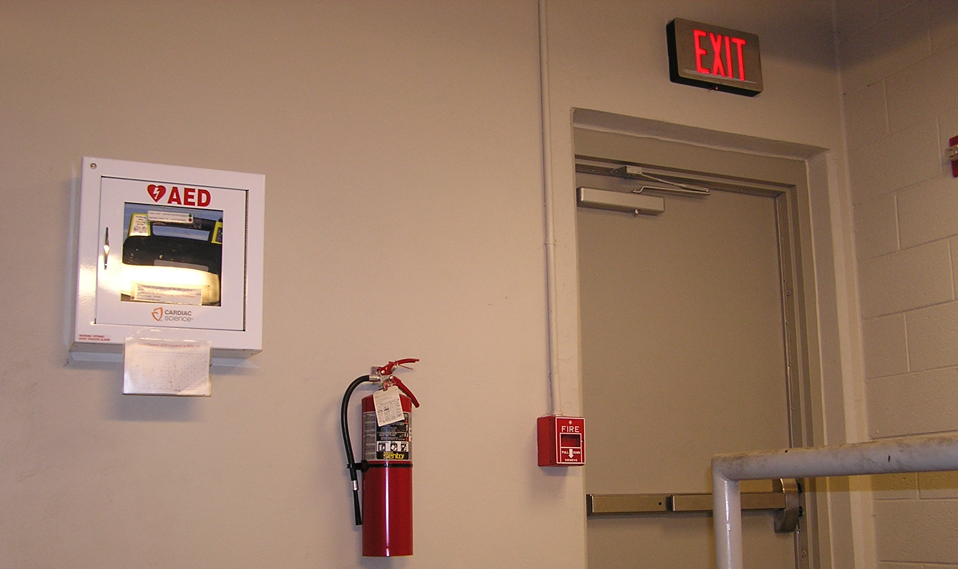
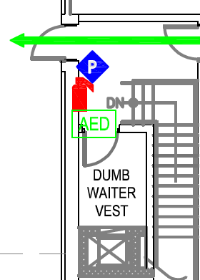
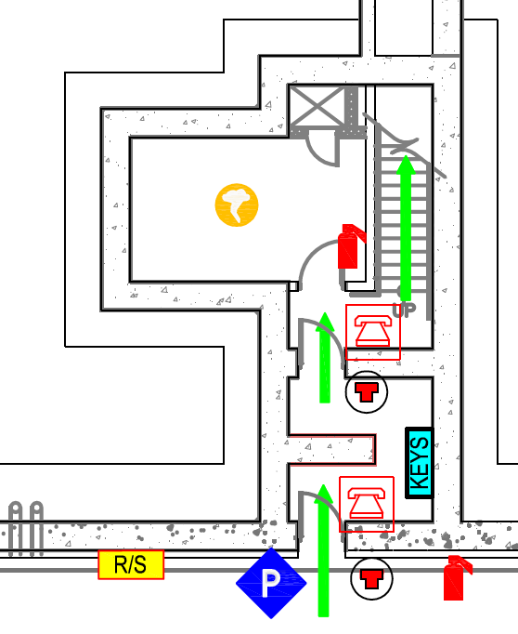
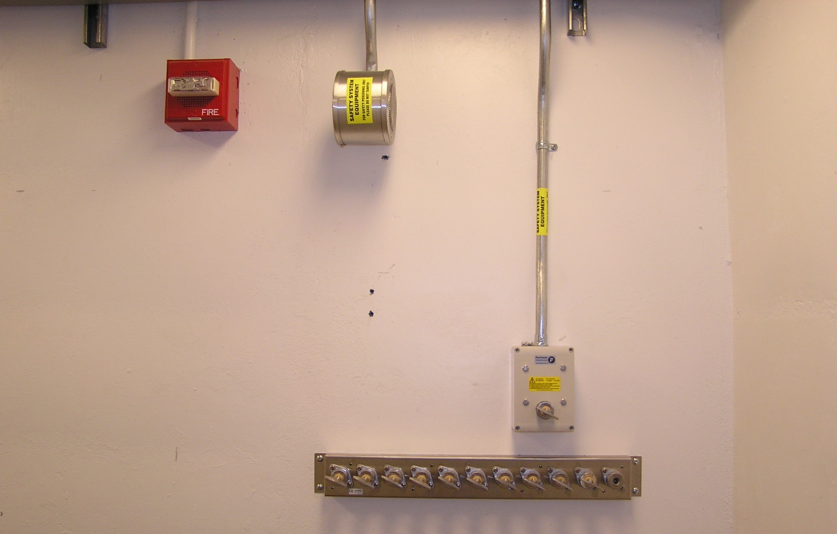
Stairwell
Automated defibrillator
Fire pull station
Severe weather
shelter
Fire alarm
Key bank

Slide 3
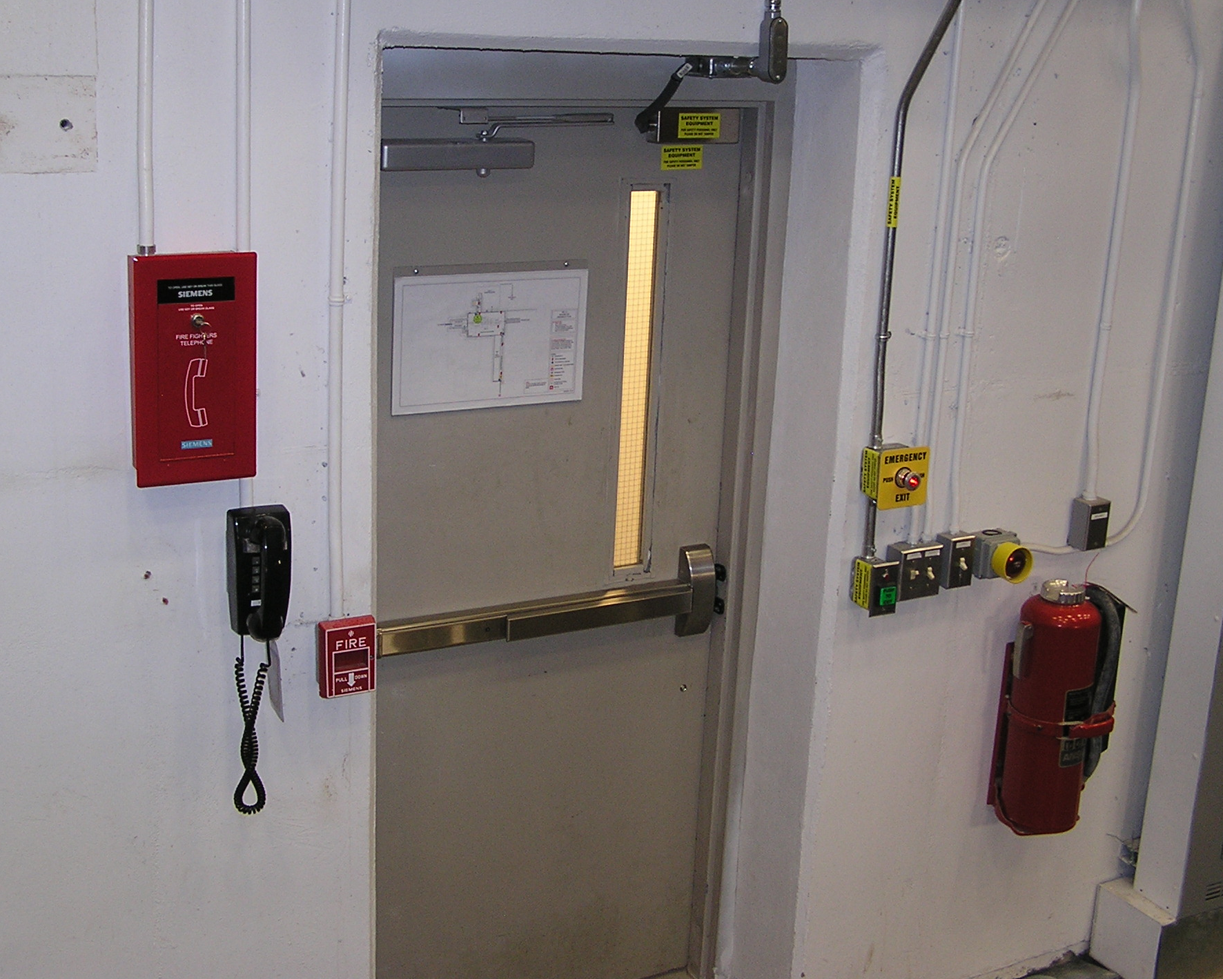
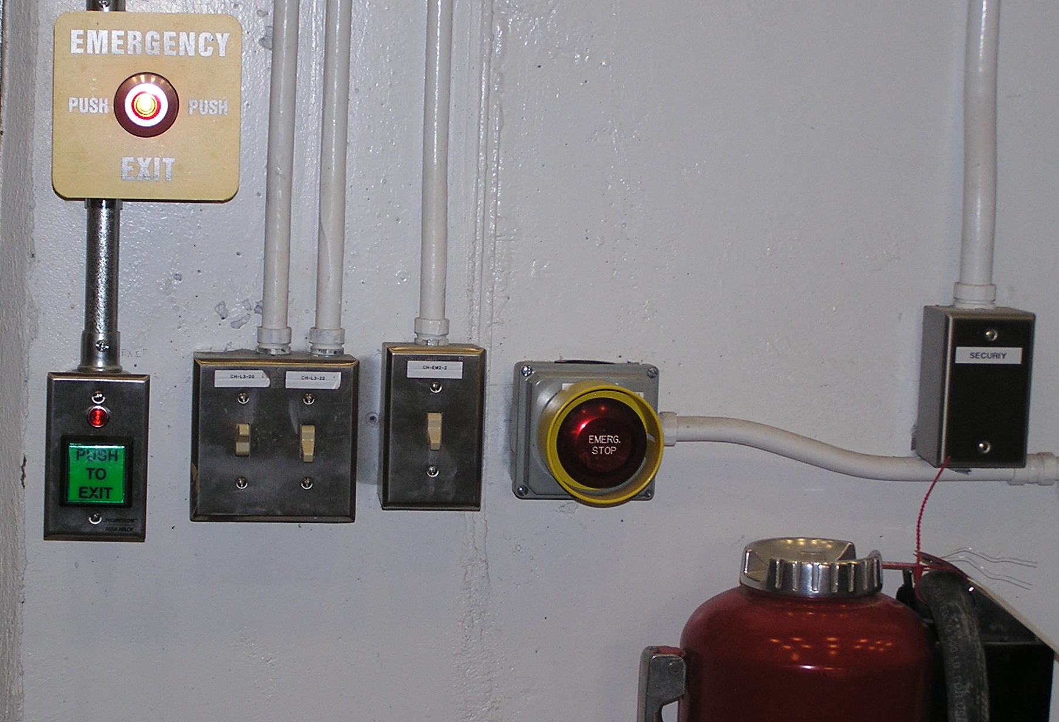
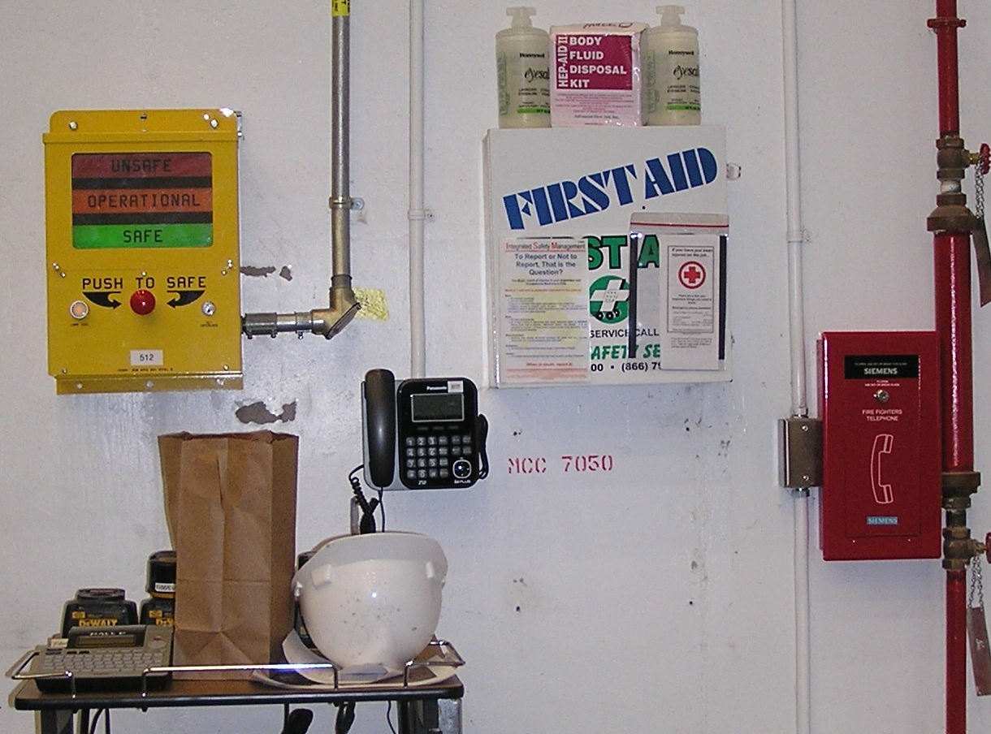
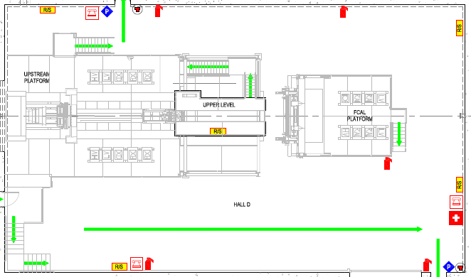
Experimental Hall D
Emergency
Exit button
Power kill button
Trips all power in Hall except emergency power
Exit button
Note: Both Exit Buttons disable mag locks on door
Fire pull station
Fire extinguisher
Run Safe Box
First Aid

