Slide 1


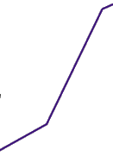
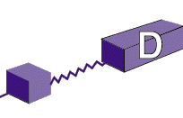
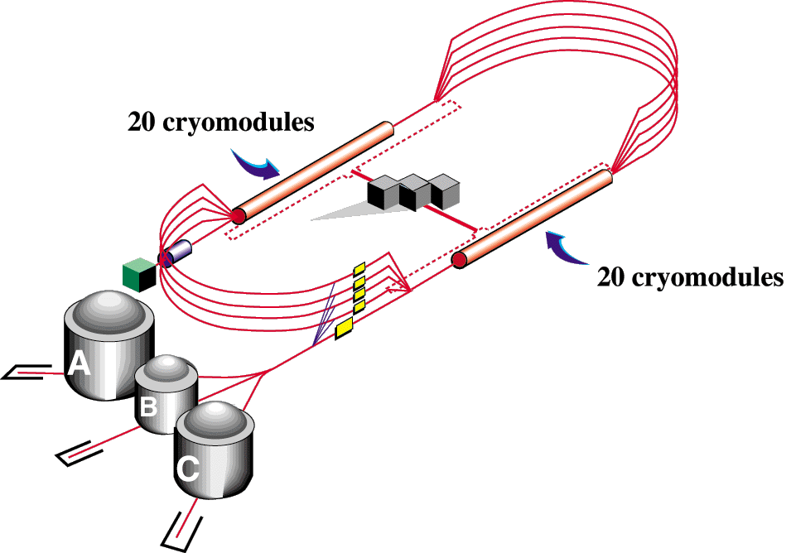

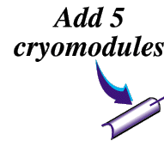
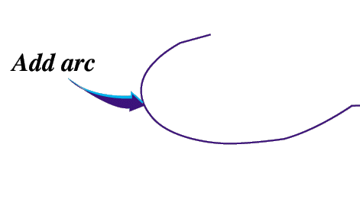


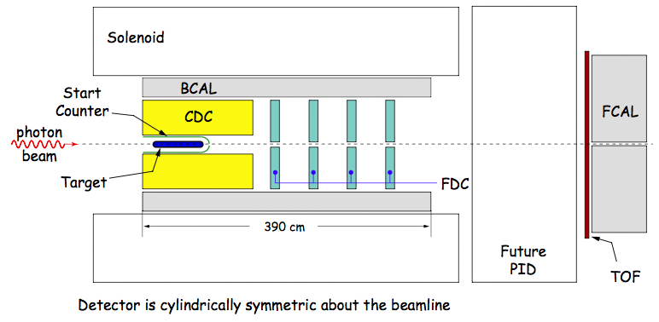
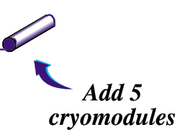
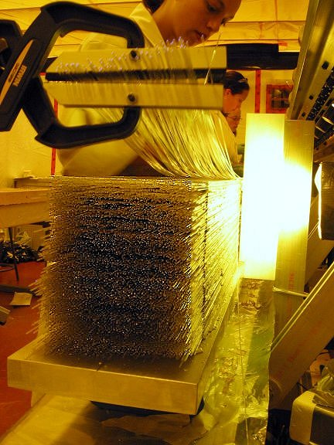
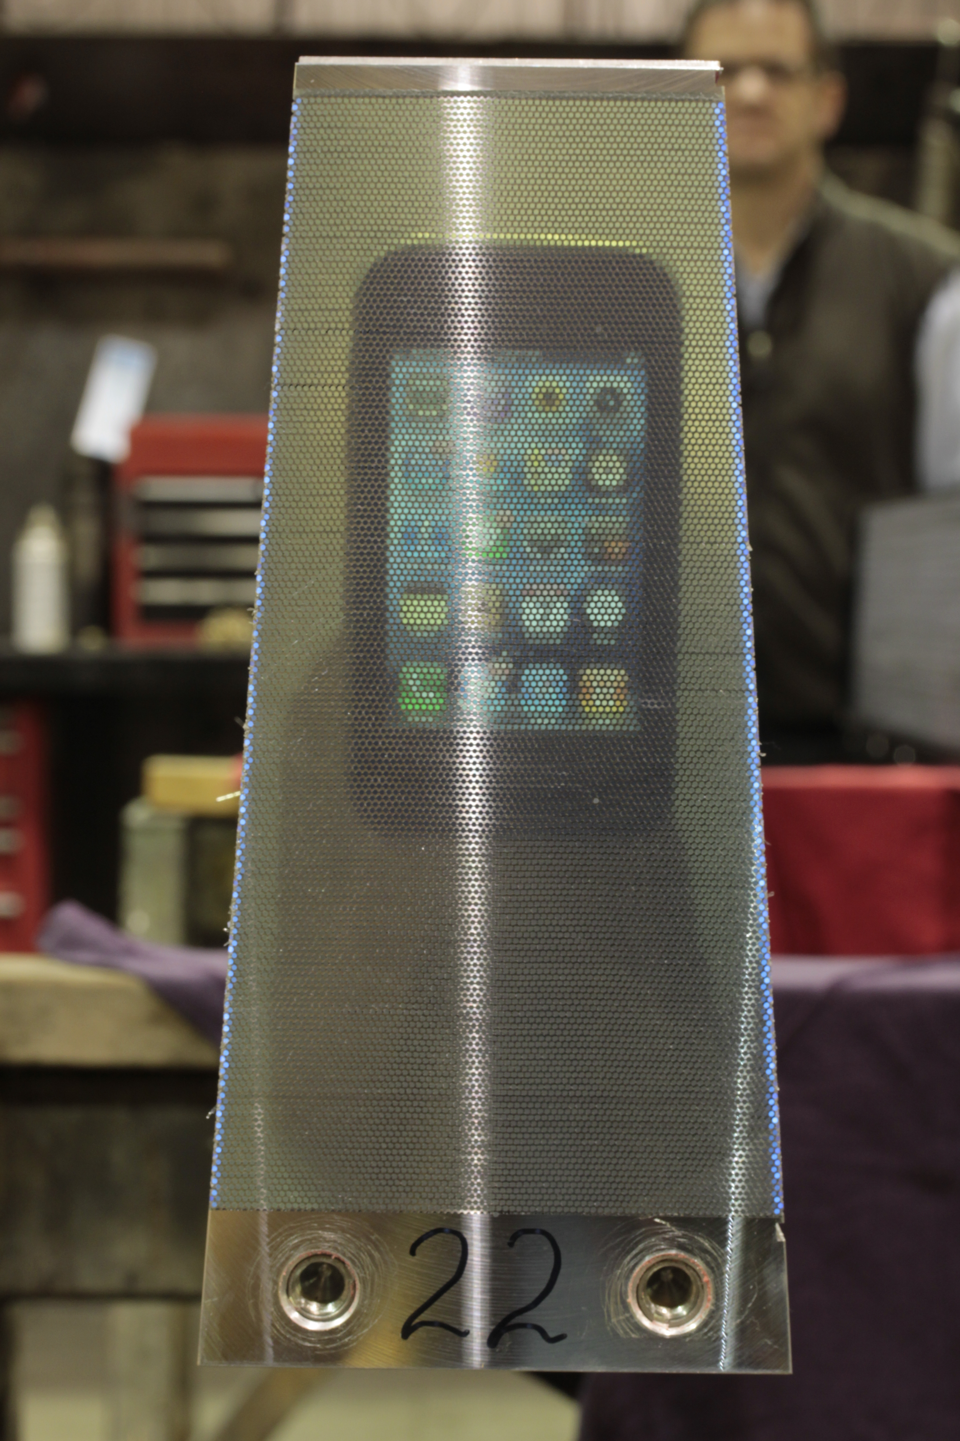
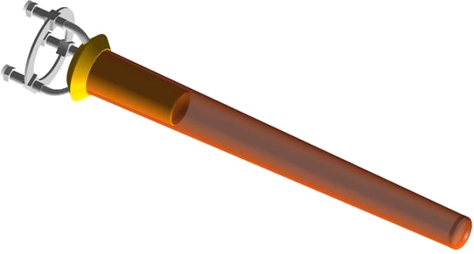
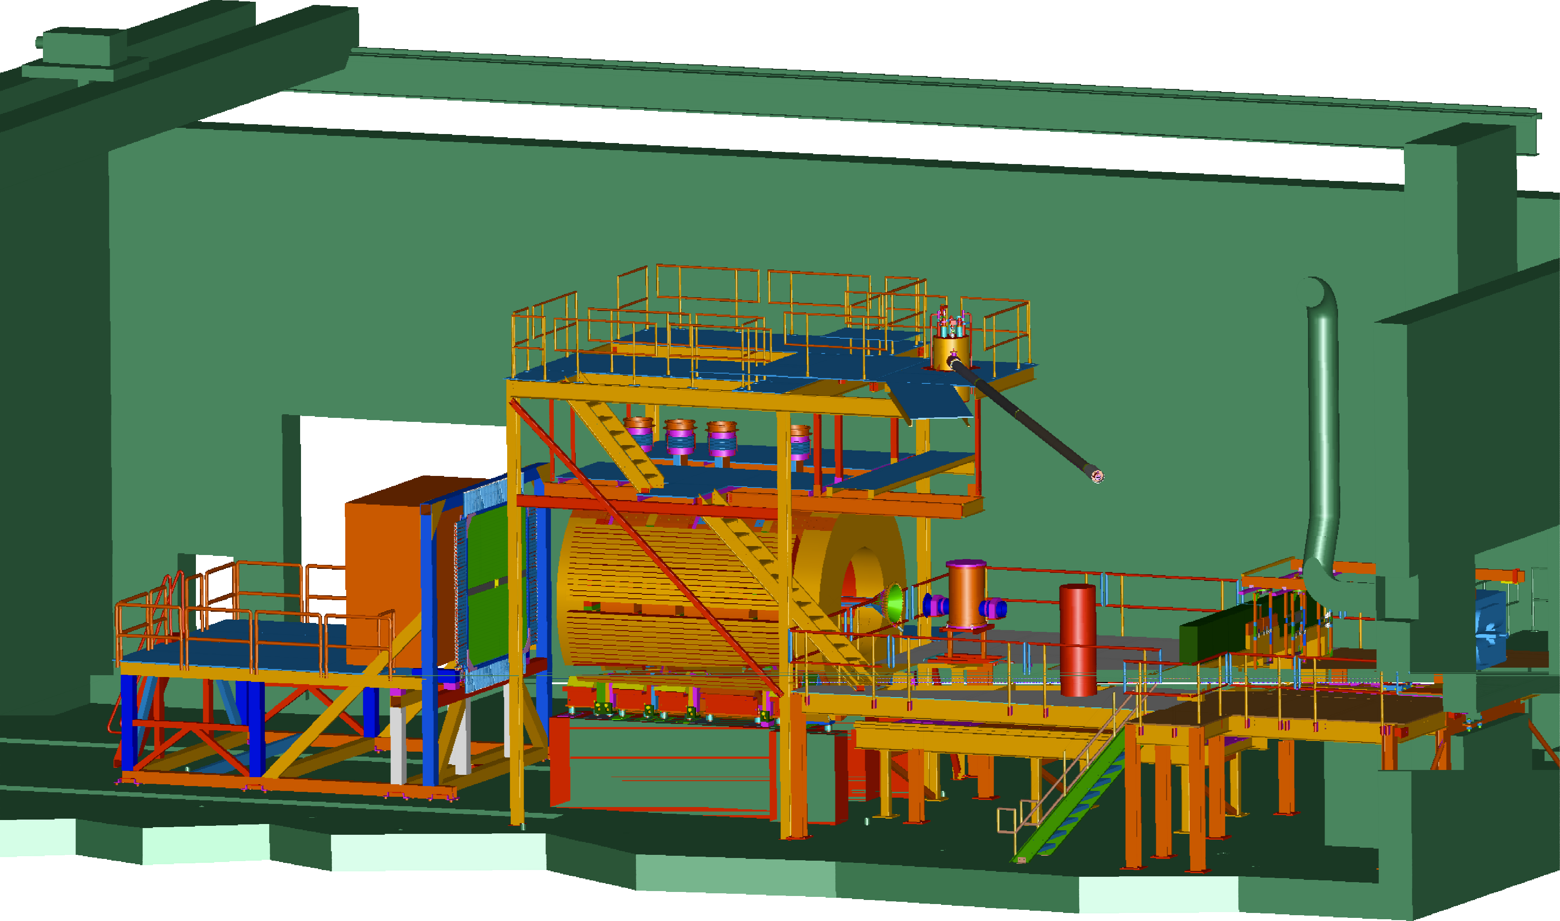
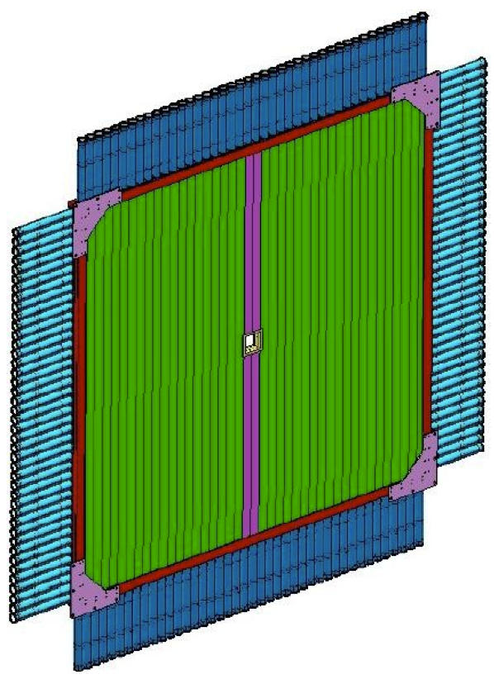
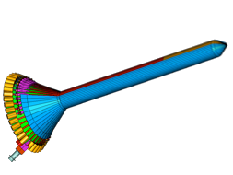
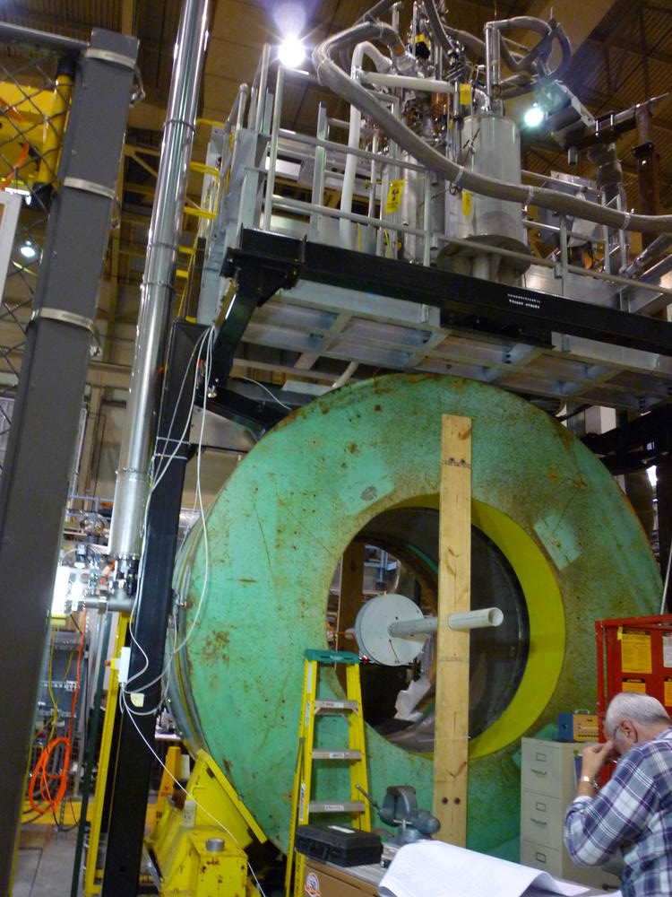
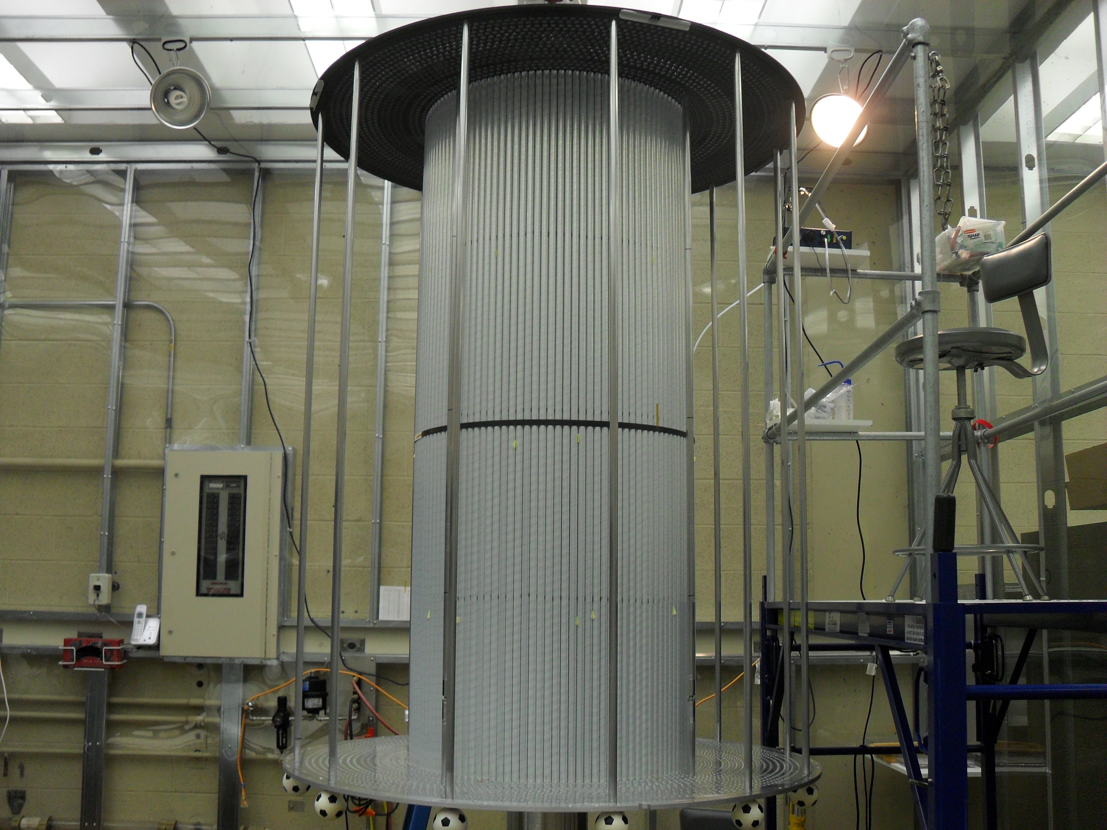
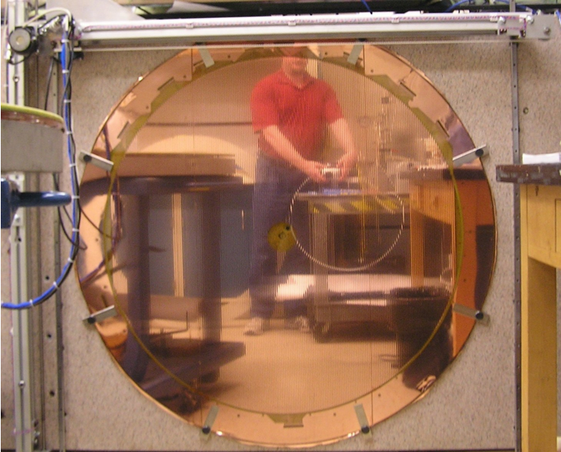
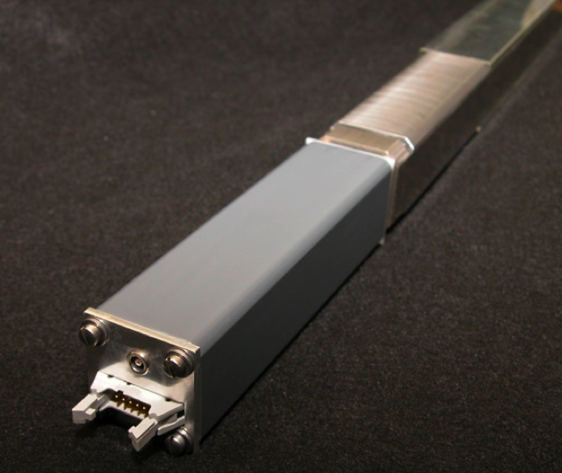







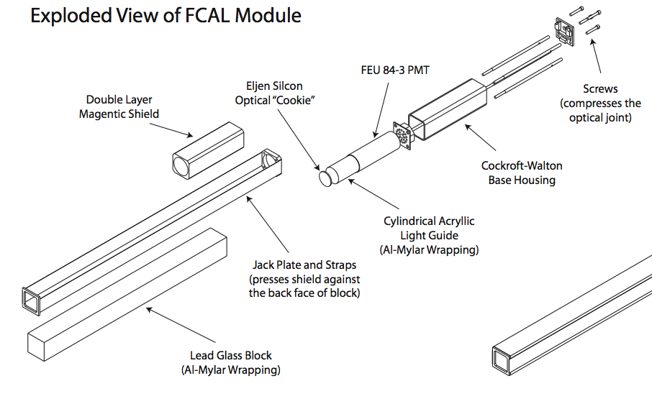
The GlueX Detector
CHL-2
Barrel Calorimeter
48 modules arranged into cylinder
Scintillating fiber + Pb
12.5% sampling fraction
11º < θ < 120º
Double-ended readout
3000 km of fiber
schematic of GlueX detector
Forward Calorimeter
Start Counter and Target
2800 Pb-glass blocks
4cm x 4cm x 45cm
2º < θ < 11º
BCAL module being assembled from layers of fibers and Pb
Polished BCAL module demonstrating optical clarity with cell phone held to opposite end
Target
LH₂ or LD₂
30 cm long Kapton tube
3 cm diameter
FCAL module showing assembled phototube and Crockoft-Walton base.
Drawing showing an exploded view of the FCAL module assembly.
Target
Time of Flight
Hall-D
Start Counter
40 scintillators
18 cm diameter
σ_{t} ~ 300ps (w/ tracking)
Light guide + photodetectors
2.5cm-thick scintillator
2 planes
44 bars per plane (40 with double ended readout)
σ_{t} ~ 60ps (both planes)
2º < θ < 11º
TOF
Truck Ramp
Start Counter
γ beam
Superconducting Solenoid
CAD rendering of TOF detector.
Forward Drift Chambers
4 packages, 6 planes/package
sense wire readout
  96 wires/plane
  2304 sense wires
cathode strip readout
  48 cathode planes
  216 strips/plane
  10,368 strips
σ_{r} ~200μm perpendicular to wire (drift time)
σ_{s} ~200μm along wire (cathode strips)
1º<θ<30º
Central Drift Chamber
2T field
1500A
8.5 m³ interior volume
Used previously for LASS at SLAC and for MEGA at Los Alamos
3500 straw tubes
12 axial layers
16 stereo layers (6º)
dE/dx for p<450 MeV/c
6º < θ < 155º
FDC cathode plane mounted on flatness scanner.
Testing one of the four coils at JLab that make up the GlueX solenoid.
GlueX CDC under construction at in a clean room at Carnegie Mellon. The straw tubes are in the interior region while support braces can be seen on the out edge.
DIS2011 tour: April13, 2011
D. Lawrence

