Slide 1


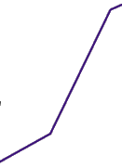
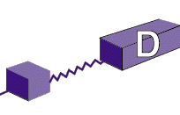
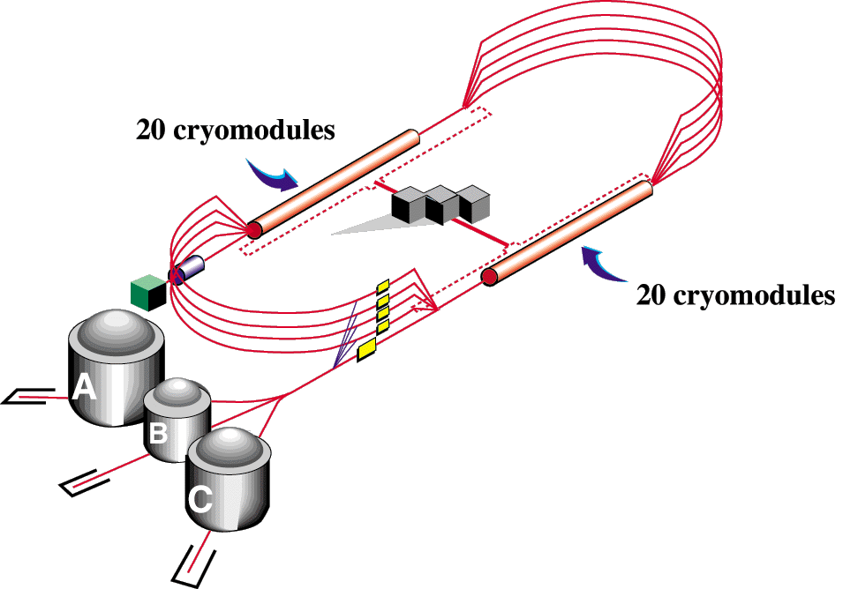
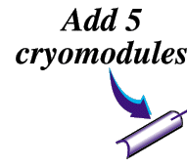
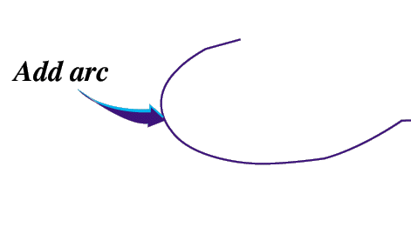


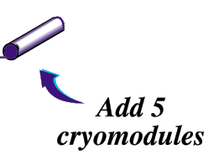
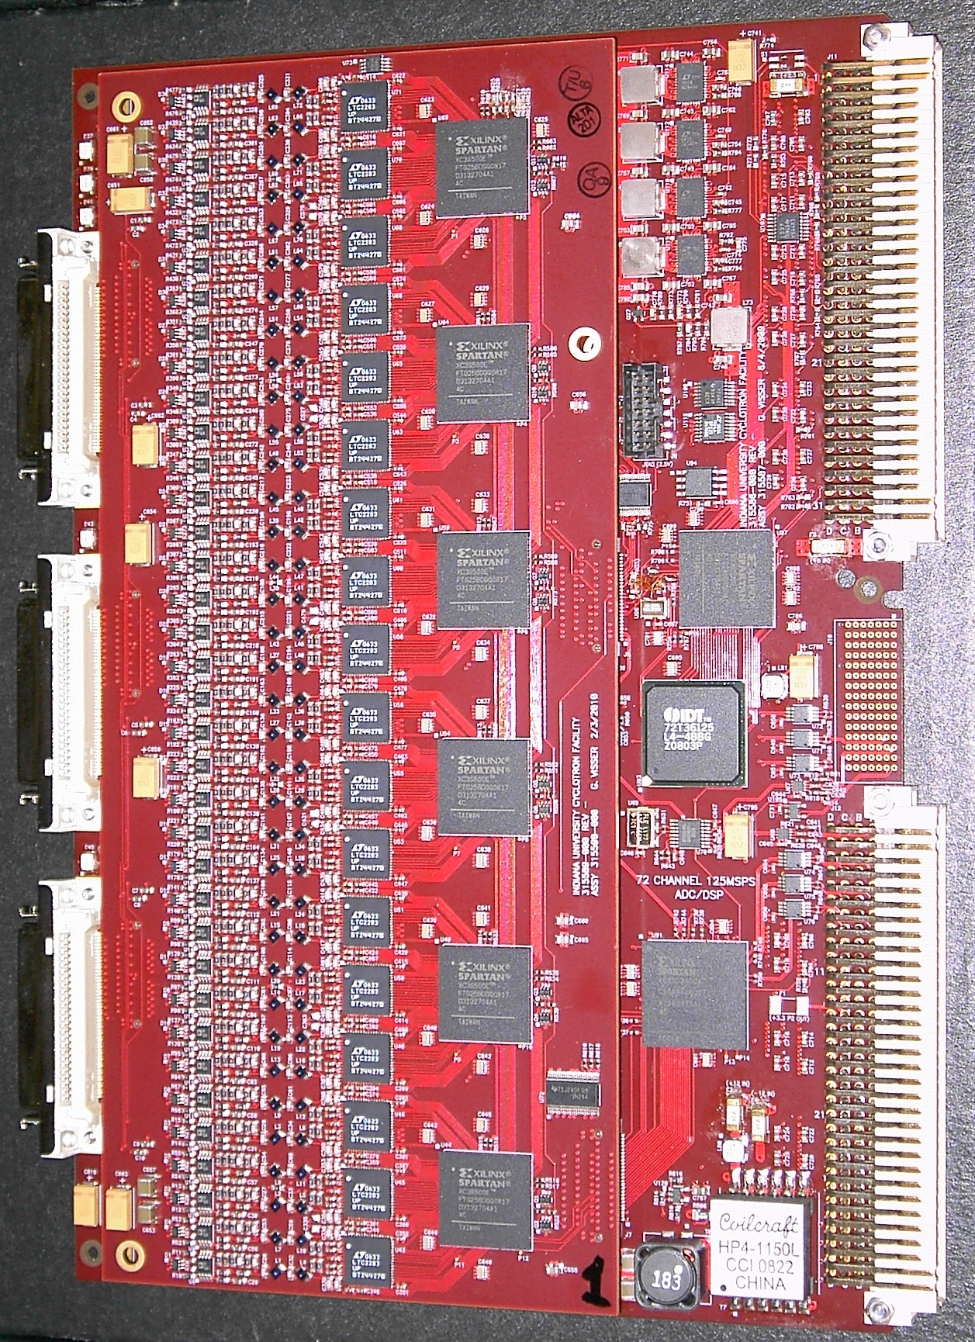
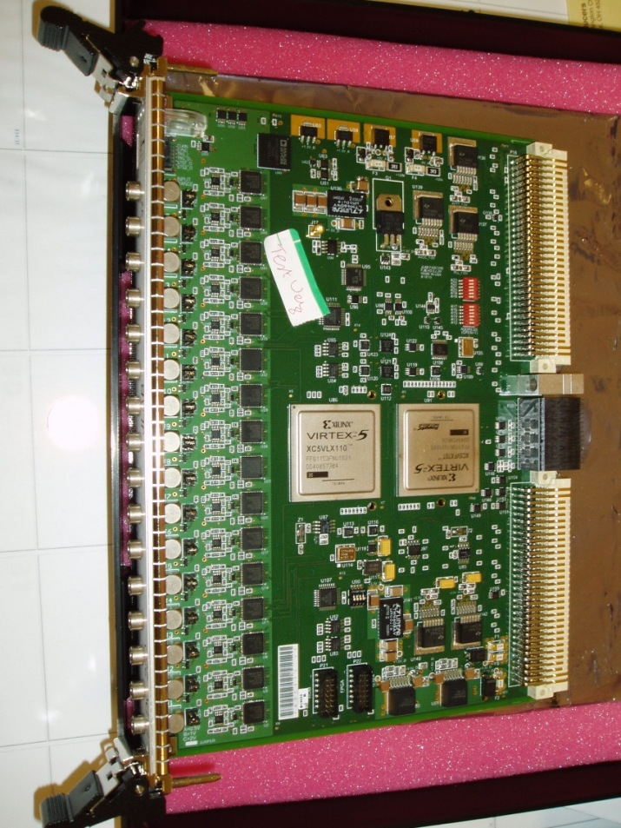
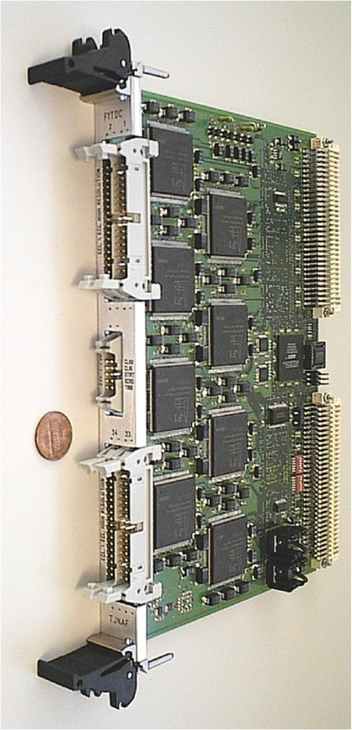
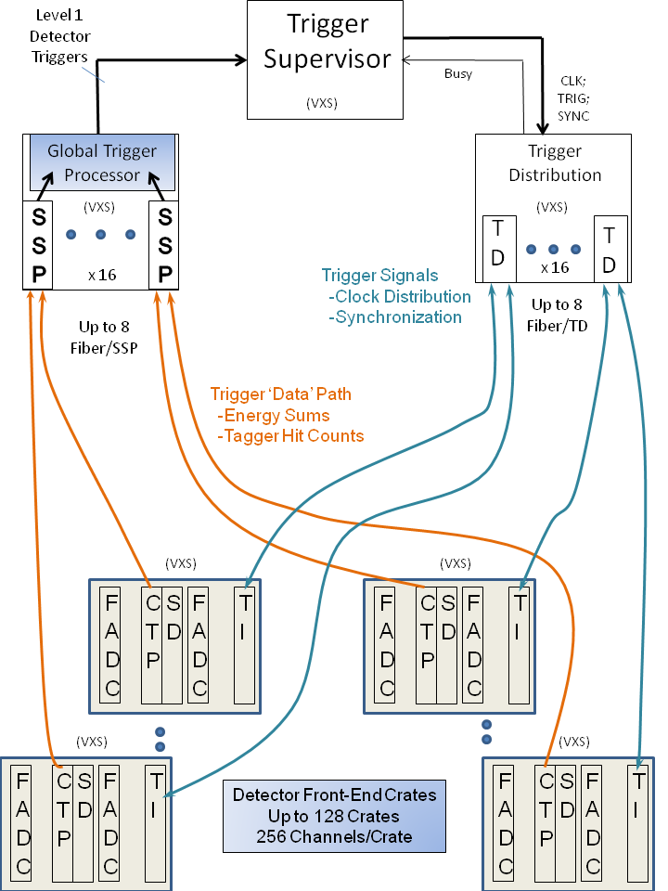
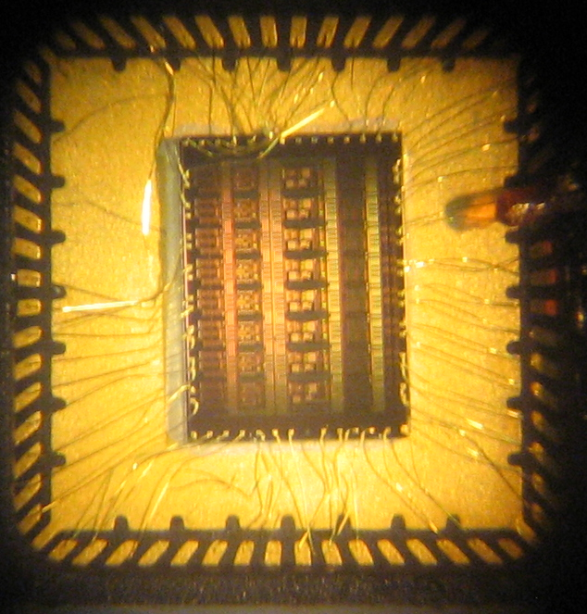
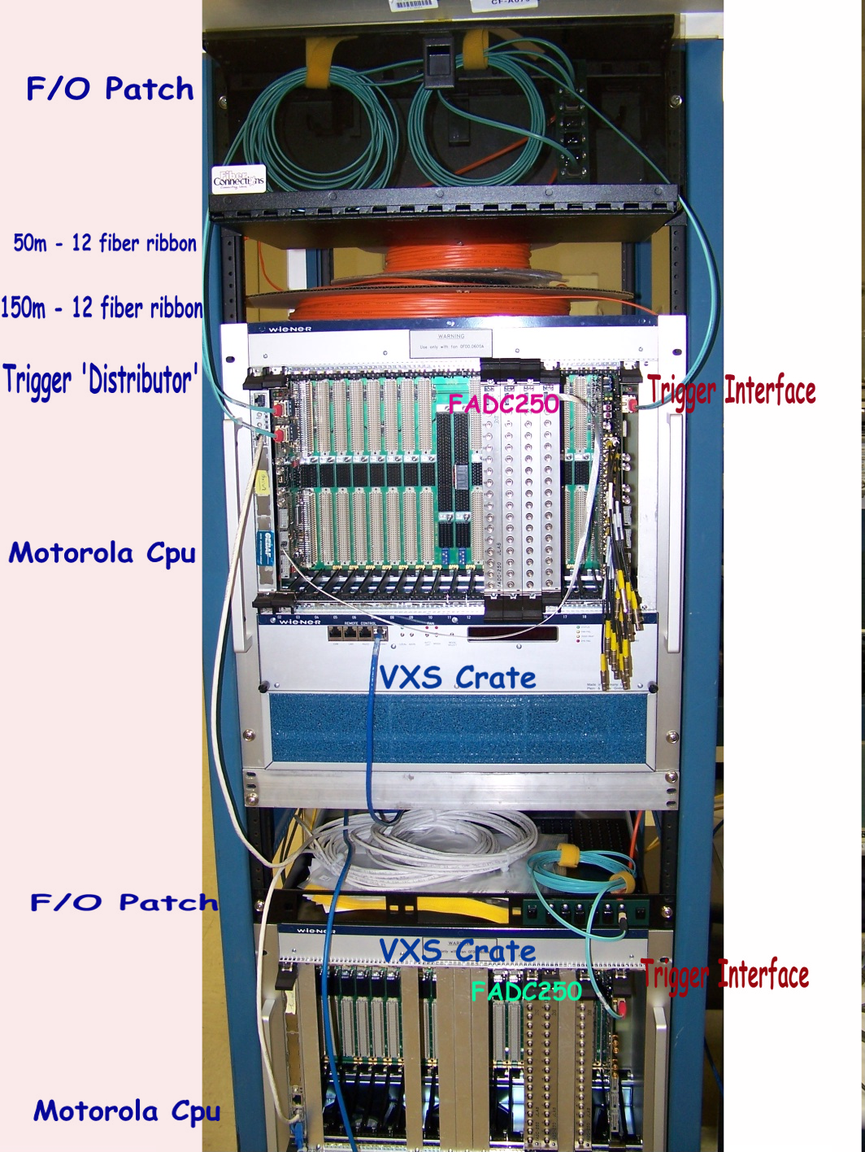
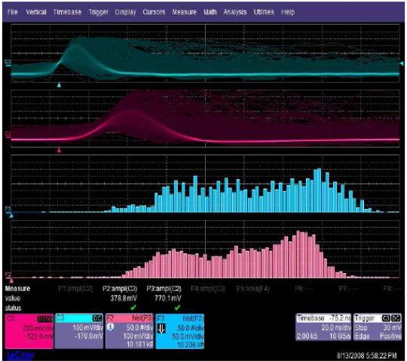
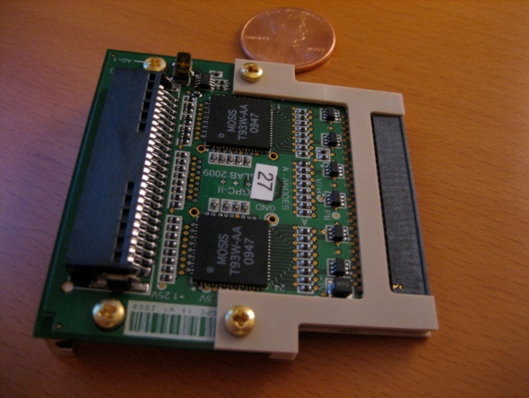

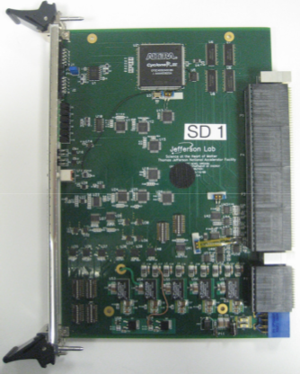
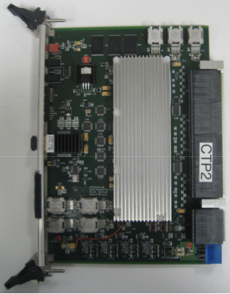
GlueX Electronics
CHL-2
Fully Pipelined Custom Electronics
Digitization
The GlueX experiment will utilize fully pipelined front end digitization electronics. This means that the detector signals will be continuously digitized in the front end boards, storing the values in on-board memory.
When a Level 1 trigger is received, the board will look back in time to the appropriate memory location and apply an FPGA-based algorithm. The program delivers sparsified signal sums and times from the Flash ADCs and times from the TDCs to the readout.
Eventually, the integral and time values will be transported off the board through the VME backplane.
125 MHz Flash ADC
125 Msps
12 bits
72 channels
VXS connection for clock synchronization
Used for Drift chambers
Memory ring buffer
250 MHz Flash ADC
250 Msps
12 bits
16channels
VXS connection for digital sum (L1 trigger) and clock synchronization
Used for calorimeters and scintillators
The ring buffers used to hold the samples for each channel are large enough to contain the last 3μs of sample data. This eliminates the need for the long, expensive delay cables used in previous generations of Nuclear Physics experiments.
Certain flash ADC modules are also equipped to sum the samples over all channels and transmit the sum via VXS (a high speed point to point connection system) to a central module to be used in the L1 trigger. A total digital sum of an entire 2800 channel calorimeter can therefore be update every 4ns. (See below)
F1TDC
60ps or 115ps LSB
12 bits
32 or 48 channels (depends on desired resolution)
VXS connection for clock synchronization
Used for Fast detectors (60ps mode) and Drift chambers (115ps mode)
Level 1 Trigger System
The level 1 trigger system (L1) will include both partial and total sums of the calorimeters. The >3500 calorimeter channels will be digitally summed every 4 ns and a threshold applied. This is done starting at the Flash ADC module level by summing all channels in the module and sending the sum over a high speed VXS connection to a dedicated Crate Trigger Processor (CTP) module.
The CTP will digitally sum the signals from all of the flash ADC modules in the crate and send the 32bit value over a high speed optical connection to a SubSystem Processor (SSP) module.
The SSP modules will each create a sum of the inputs from several crates and pass it over a VXS connection to the Global Trigger Processor (GTP) module.
Drift Chamber Pre-amp
ASIC chip
ASIC (Application Specific Integrated Circuit)
Pre-amplifier and shaper
Discriminator mode
8 channels per chip
Custom design for GlueX
~ 4 mm
Wire-bonds
(Au)
Performance of the shaper circuit in the ASIC
The GTP will create the final stage sum as well as include signals from the Tagger and Time Of Flight (TOF) detectors to form the Level 1 trigger.
GAS-1 Die
(0.25 μm CMOS)
input
Lead-frame
(QFN 64 9x9 mm)
output
input
Illustration of the Level 1 trigger system
output
A Trigger Supervisor (TS) module manages the L1 trigger and communication with all of the crates.
A Trigger Interface(TI) board and Signal Distribution(SD) board are used to distribute trigger and clock synchronization information to all of the modules in a crate.
GPC-II (GlueX Pre-amp Card)
3 ASIC chips (one underneath)
24 channels
Drift Chambers
Custom design for GlueX
GPC-II 24 channel Pre-amp Card
SD: Signal Distribution module
CTP: Crate Trigger Processor module
Two crate test setup of L1 trigger
DIS2011 tour: April13, 2011
D. Lawrence

