Slide 1
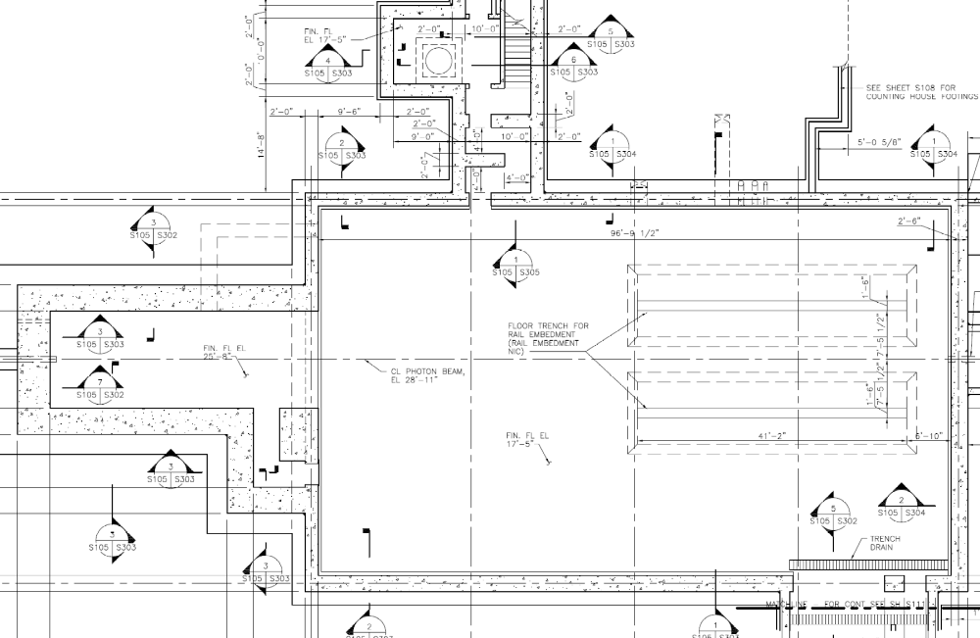
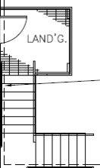
Hall-D DIS2011 Tour Plan
4/5/2011
Visitors will be met on the truck ramp by a physicist and given an introduction to Hall-D/GlueX ast they walk down into the hall.
As they enter Hall-D, they will be directed towards the various poster sites and reminded about the limited time.
Additional guides will be available at posters to answer questions
Visitors directed back to the truck ramp to exit by primary guide.
Hall-C Poster Area
This area will be roped off due to the open trenches
coils
solenoid piers
BCAL Module
SiPM
Electronics
Detector
Exit Sign
Physics
Hall-D Poster Area
12GeV Project Poster Area
Truck Ramp

