Slide 1
Hall D Offline Software Performance and Status
12 GeV Software Review III
February 10, 2015
Mark Ito

Slide 2
High-Level Software Packages
Function | Package | “Locally” Grown?
Raw Data Format | EVIO | yes
Offline Data Format | HDDM (compressed XML) | yes
Geometry Specification | HDDS (an XML) | yes
Data Acquisition Framework | CODA | yes
Simulation Engine | GEANT 3 | no
Event-Based Processing Framework | JANA | yes
Event Simulation and Event Reconstruction | sim-recon (sim: GEANT 3, recon: JANA) | yes
High-Level Event Analysis | Analysis Library (part of sim-recon) | yes
Histogramming, Fitting, etc. | ROOT | no
Amplitude Analysis (PWA) | AmpTools | yes

Slide 3
Low-Level Software Packages
Function | Package
XML Parsing | Xerces-C
Source Code Management | Subversion
Build System | SCons (some GNU Make)
Scripting | Python (some legacy Perl)
Database | MySQL/MariaDB and SQLite
Web Authoring | MediaWiki (mostly)
Data Transfer | SRM, Globus Online

Slide 4
Computing Performance Example
Computing times assume a 10,000 core Haswell farm.
Fiscal Year | 2015 | 2016 | 2017 | 2018 | 2019
Weeks of running | 2 | 16 | 25 | 18 | 22
Trigger Rate (kHz) | 2 | 20 | 20 | 20 | 20
Number of events (billions) | 1.2 | 97 | 151 | 109 | 133
Reconstruction time (days) | 0.06 | 5.1 | 8.0 | 5.7 | 7.0
Recon.+Sim. Time (days) | 0.6 | 50.9 | 79.5 | 57.2 | 70.0
Total data to tape (PB) | 0.05 | 4.0 | 6.3 | 4.5 | 5.6

Slide 5
Computing Requirements Discussion
Estimate of cores needed reduced by a factor of 3 with new Haswell chip relative to assumption of last estimate.
Running time per year has decreased
  Peak of 25 weeks in FY17 vs. 35 weeks in last estimate.
Simulated data creation time has gone up factor of 7 relative to reconstruction since last estimate.
  Original estimate suspect
  Experimental resolution inclusion: much slower now.
  Improvement likely possible, unimproved number used.
Commissioning data: event reconstruction rate 50% better than that on simulated data, but…
  “junk” events not accounted for yet (event fraction, recon. rate)
  Beam-spectrum/trigger not realistic (different center-of-mass energy)
  Code base slightly different (for commissioning geometry, recent improvements)

Slide 6
Data Challenges (DCs)
DC1 - December 2012/ January 2013
  5 billion Events - OSG, JLab, CMU
  1200 Concurrent Jobs at Jlab
  Data produced used to support proposal for GlueX Phase IV running
DC2 - March/April 2014
  10 billion events with EM backgrounds included - OSG, JLab, MIT, CMU, FSU
  4500 Concurrent Jobs at JLab
  11,000 Concurrent Jobs on the OSG
  Well under 0.1% failure rate
DC3 - January/February 2015
  Read data in raw-event format (EVIO) from tape and produce DST format (REST) files.
  JLab only
  Test throughput from Tape Library
  Run Multi-threaded jobs

Slide 7
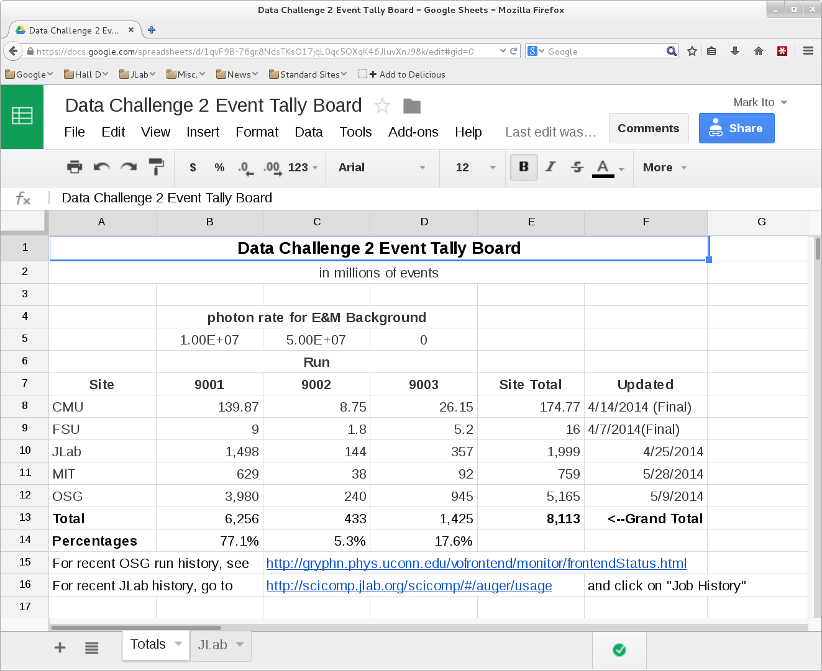

Slide 8
Offline Monitoring
Weekly reconstruction pass through data
  All data as of Friday afternoon
  Online monitoring plots reproduced
  Full reconstruction with updated code and constants
  Skims of raw events done for calibration
  DST data produced (REST format)
Web site for browsing results
REST data good enough to observe multi-particle final states
Continuing on a bi-weekly schedule
Paul Mattione (CMU), Kei Moriya (ASU), Justin Stevens (MIT), Sean Dobbs (NU)

Slide 9
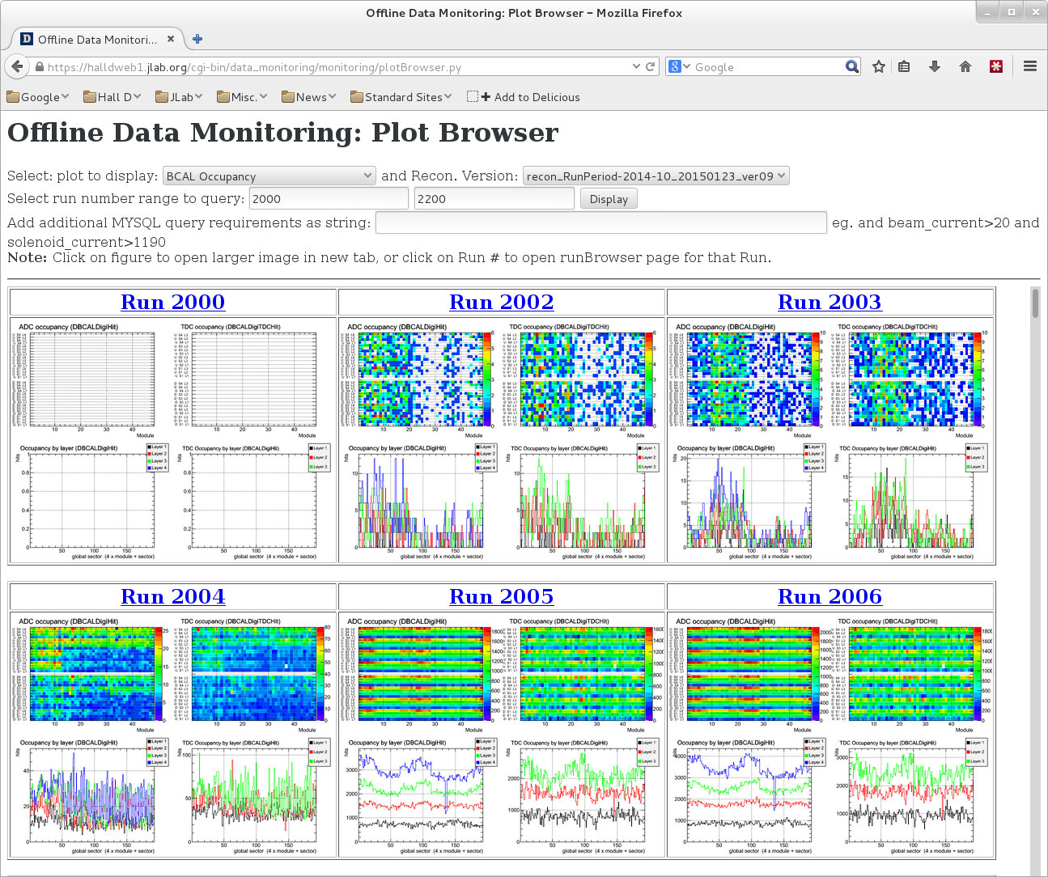
Plots for a selected range of runs

Slide 10
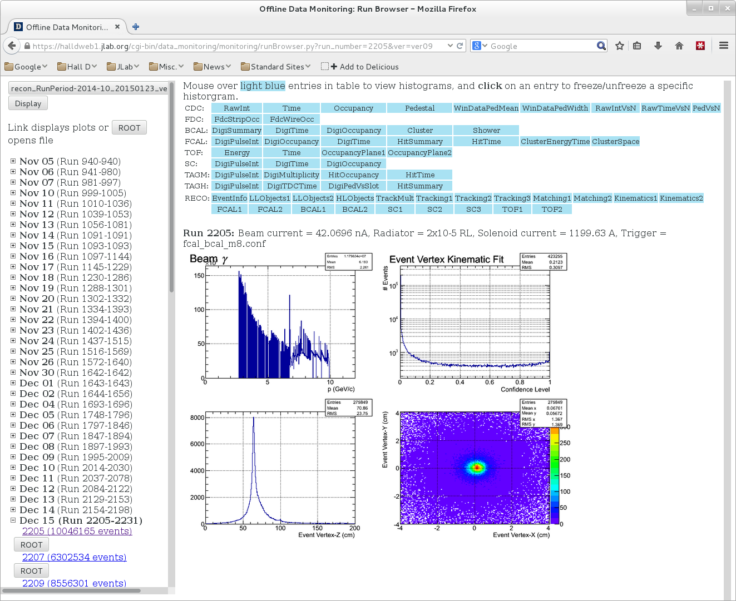
Plots for a given run

Slide 11
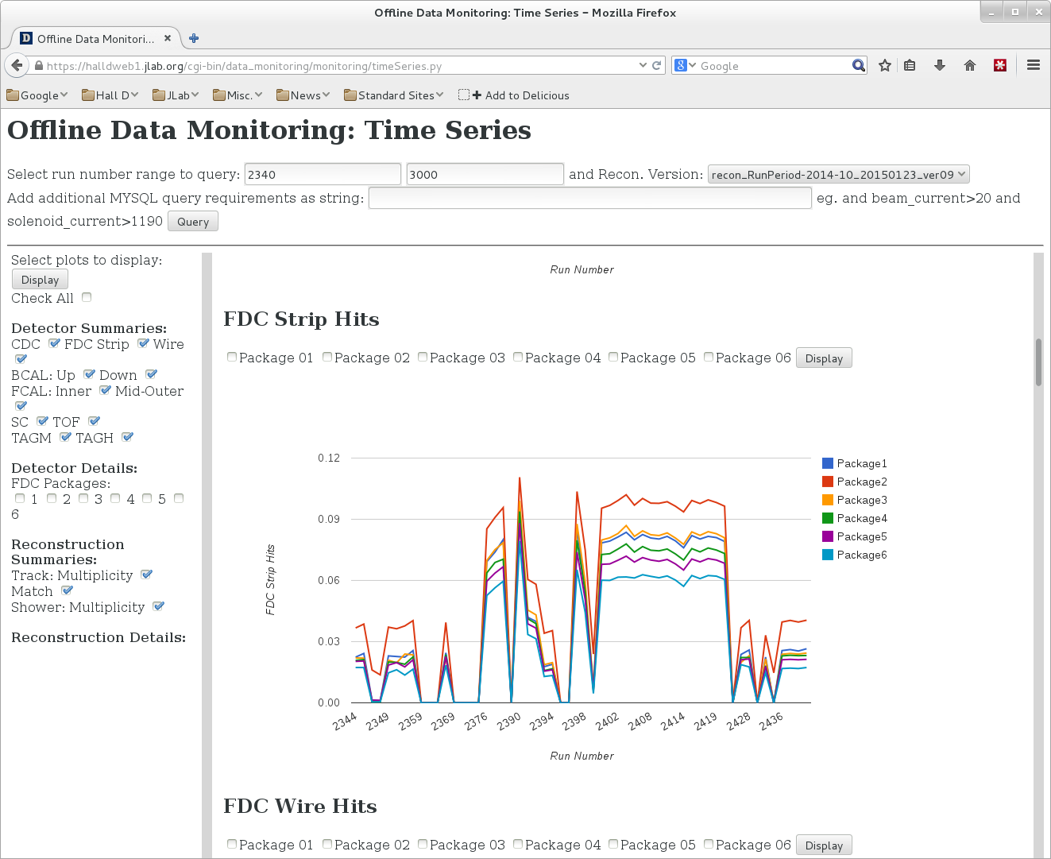
Quantities as a function of run number

Slide 12
Calibration Working Group
Bi-weekly meetings
  chaired by Sean Dobbs of Northwestern
Preliminary list of constants compiled in advance of run, used to guide activity
Calibration procedures still being developed
Substantial progress:
  Basic timing offsets
  Global energy scale for calorimeters determined
All collaborating institutions involved.

Slide 13
Calibration Database Experience
Fully integrated into reconstruction
Near-complete migration of constants into database
All detector groups making contributions (no known rogue systems)
SQLite form of database as alternate to MySQL/MariaDB
  Complete history and versioning support
  Solves:
    Distribution (remote sites, network-challenged computing)
    Server contention from farm usage
  Drawback: no automated back-annotation

Slide 14
Data Distribution
Used OSG SRM to archive DC2 OSG results to JLab Tape Library
Raw data shipped to CMU using Globus Online (raw data)
Distribute REST data to outside institutions

Slide 15
Event-Based Data Management
Raw data stays on JLab Tape Library
Reconstructed REST-formatted data compact
  Fall 2014 REST data only 113 GB total
  Keep as much as possible disk-resident at JLab
  Distribute most (all?) to collaborating institutions
Data Catalog/Tracker needs development
  Existing package?
  Develop one?
  Dependence on details of how data distributed

Slide 16
Online Conditions Database
Database to store online run conditions, e. g., magnet current settings, configuration files, etc.
Two were deployed
  One looks great (API, modern web interface)
  One was useful (hand work required, HTML-base web interface, CSS-free)
  Effort underway to consolidate and expand.

Slide 17
Things To Do
Real data exposed areas requiring further work:
  Online Conditions Database
  Data Catalog
  Version Management
    Made branch to deal with non-standard detector configuration
    branch-to-trunk merge problematic
Geant4: need to pick up the pace of development
Still need profiling discipline!
  Simulation speed has decayed
Code review system needs design and implementation
  Size of collaboration makes this a challenge
Never-ending data challenge never got started

Slide 18
Summary
Software performed all critical tasks needed to support detector commissioning and to see physics signals.
The collaboration feels that we reached a number of milestones that we did not expect to see until the April 2015 run.
In turn, schedule for development of some facilities needs to be advanced.
Most basic tasks lie ahead: calibrations, monitoring, reconstruction Q/A.
Software infrastructure to support these activities largely in place.

