Slide 1
Calibration and alignment database development
Dmitry Romanov
September 21, 2010

Slide 2
Overall design
Interfaces
WEB
Console
Tools
JANA and C++ Users
Python USERS
PHP
Calib. DB API
C++
Python API
MySQL Provider
File DB Provider
My SQL Server
Local DB File

Slide 3
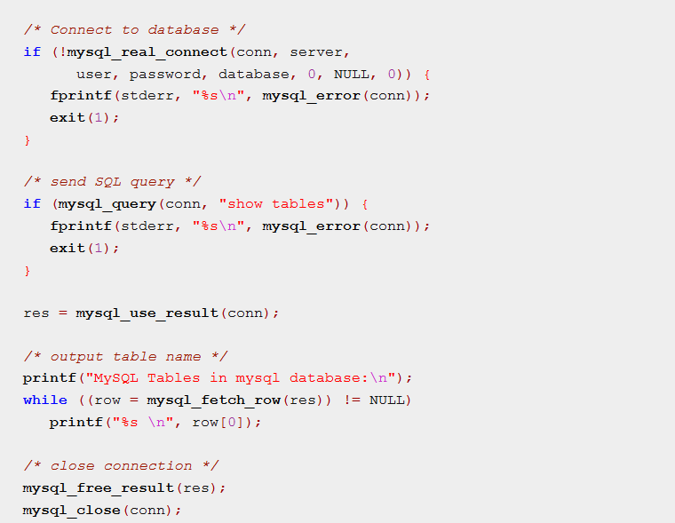
MySQL C API Usage
MYSQL *conn;
Connection handler
MYSQL_RES *res;
Resource handler
MYSQL_ROW row;
Row structure

Slide 4
MySQL C API
Advantages of using MySQL C API
Pure API, not bloated by any wrappers.
Disadvantages
May change from version to version of MySQL
“Heavy” wrapping is needed to build desired architecture.
It is only for MySql.
Tricky functions
Not a thread safe

Slide 5
Root DB Framework
TSQLServer
TMySQLServer
TPgSQLServer
TOracleServer
TSapDBServer
TODBCServer
TSQLServer may accept connection string: <dbms>://<host>[:<port>][/<database>]
Depending on the <dbms> a static function Connect() will use an appropriate plugin which will provide the real interface.
TSQLServer *db = TSQLServer::Connect("mysql://localhost/test", “login", “pwd");
Actual (dynamic) type will be TMySqlServer *
Base classes
TSQLColumnInfo - Information about column from SQL table
TSQLResult - SQL query result
TSQLRow - One row of an SQL query result
TSQLServer - Connection to SQL server
TSQLStatement - SQL statement
TMySQLResult
TSQLResult
TPgreResult
T…Result
TSQLStatement – provides bufferised IO and some DB unification.

Slide 6
Root DB framework examples
TSQLServer *db = TSQLServer::Connect("mysql://localhost/test", "nobody", "");
res = db->GetTables("test"); //List all tables in database "test"
res = db->Query("select count(*) from test”); //Query
Int rows = res->GetRowCount(); //Get rows number
Int flds = res->GetFieldCount(); //Get rows count
while ((row = res->Next())) {
row->GetField(0)); //Get Data row by row
}
delete res; //Release resources
delete db; //Close connection

Slide 7
TSQLStatement
Statement allows to combine several identical
queries to one query.
Example
// first, create statement
TSQLStatement* stmt = serv->Statement(
"INSERT INTO TESTTABLE (ID1, ID2, FFIELD, FVALUE) VALUES (?, ?, ?, ?)", 100);
for (int n=0;n<357;n++) //loop insertion
if (stmt->NextIteration()) //Tell about next iteraction
{
stmt->SetInt(0, 123); //Fill values
stmt->SetUInt(1, n+10);
stmt->SetString(2, Form("name %d",n), 200);
stmt->SetString(3, Form("value %d", n+10), 200);
}
stmt->Process(); //Process all statements as one query

Slide 8
To use or not to use Cern ROOT
Advantages of using ROOT
Has complete DB framework (works with all common databases)
Database framework accepts connection strings, has a flexible “plugin” structure and is very close to JANA desired architecture.
Maintained by CERN programmers. Designed for such tasks.
Most probably API will not change with new MySQL versions.
ROOT runs on different platforms.
Has miscellaneous classes and modules (Threading, directories)
Has handy debugging tools.
We already bounded to ROOT in JANA
Disadvantages
We will stick to ROOT.

Slide 9
Other C++ DB Frameworks
MySQL++ - old (developed since1998) package. Widely uses STL C++ library and its approaches.
MySQL Connector/C++ - new library developed by MySQL team. Still changing API. More Java like API.
Both have some more dependences (like boost library), only
libdbi - a database-independent abstraction layer in C
All big frameworks like QT have its own DB API

Slide 10
Data “Blob”
1.12321|1.22345|45|15|This is user string|0.5602e-4|…
What If user’s string “have | in it” ?
function Encode(“have | in it”) → “have &pipe; in it” → DB
function Decode(“have &pipe; in it” ) → “have | in it” → USER
What about performance?
Core 2 Duo 1800 GHz, 2 Gb ddr2 ram, Fedora 13, one thread, doubles with 8 digits
Parse of 52000 values:
atof 0.08 sec, atof+verification 0.12 sec, STL isstream 0.11 sec
Parse of 1000 blobs with 52 double values per blob:
atof 0.1 sec, atof+verification 0.13 sec, STL isstreams 0.13 sec
What about size? (text blob or data blob)
double – 8 bytes, UTF-8 symbol – 1 byte.
8 digit (But who use such!?) double → 10 bytes (8 digits + point + delimiter) of text.
0.00000045 → “45e-9|” = 6 bytes instead of 8.
1 100 000 records with data blobs; MyISAM engine → 540 Mb MySQL files.

Slide 11
Performance budget
1 100 000 records with data blobs; 52 double values (8 digits) for each blob.
Queried randomly with 1100 queries.
Core 2 Duo 1800 GHz, 2 Gb – 0.23 sec
Core i7 @ 2800 GHz, 8 Gb – 0.04 sec
Stick to 1 second to load calibration constants
Data queries – 0.23 sec
Blob parsing – <0.13 sec
Net transfers – ?
Framework overhead – ? (should be relatively small )
Pre queries – ? (should be around 0.1 sec)
Conclusion: quite possible to keep in 1 second.

Slide 12
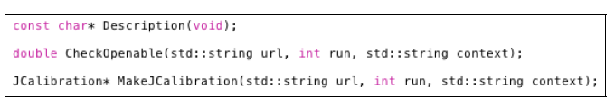
JANA interface
Two main parts:
1) JCalibrationGenerator A generator class (e.g. JCalibrationGeneratorMySQL)
2) Jcalibration class implementing the backend itself.
Retrieve calibration constants from CCDB (GetCalib())
Insert calibration constants into CCDB (PutCalib())
Discovery of available constants (GetListOfNamepaths())
Identication of event-level boundaries (RetrieveEventBoundaries())
Framework accepts connection strings:
“mysql://halld user@halld db.jlab.org”

Slide 13
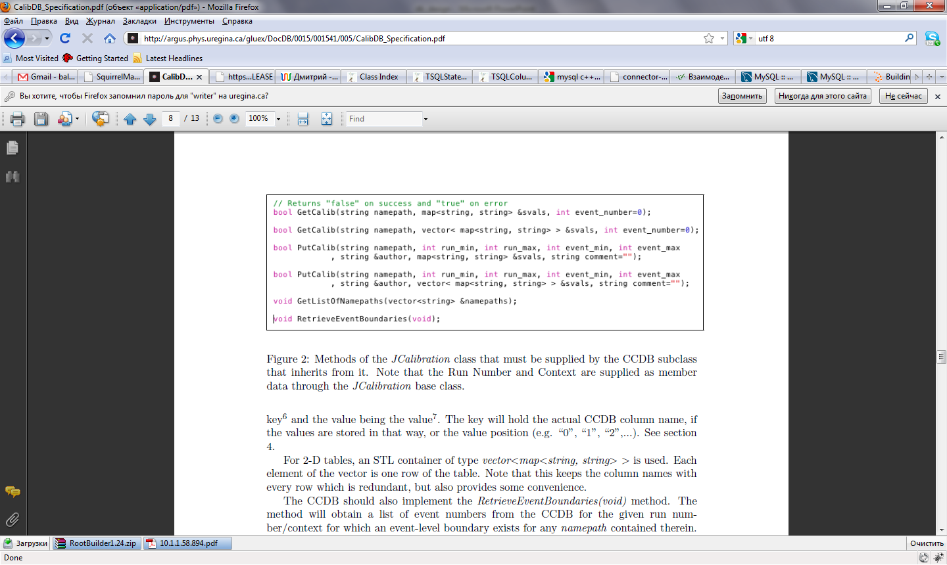
User Interface
Vectors work fine, when the table rows have the same types:
double | double | double | double | double | double | double | double | double
But what should we do if we have combined table?
double | int | string| double | string| double | double | double | int|double
Type-specific accessor functions.
Example :
float getFloat(string columnName, int rowNumber);
int getInt(string columnName, int rowNumber);
vector<float> getFloatVector(int rowNumber);

Slide 14
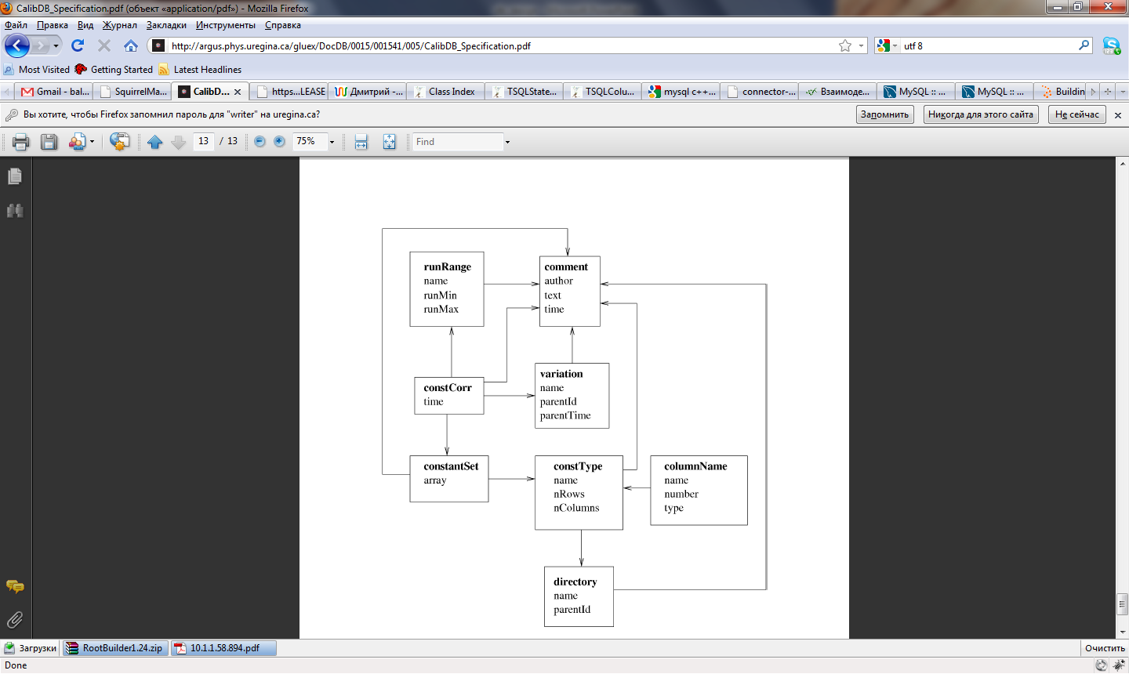
Types consistence
Types MUST consist
DB
int
int
double
error
string
Can autogenerated classes help a data consistence?

Slide 15
Table structure
If we have tables lets present it as tables
double | int | string| double | string| double | double | double | int | double
We may handle it like table
ColumnInfo | ColumnInfo | ColumnInfo| ColumnInfo| ColumnInfo
DataRow
DataCell
DataCell
DataCell
DataCell
DataCell
DataRow
DataCell
DataCell
DataCell
DataCell
DataCell
Table *table = db->GetTable(“path/to/data”)
table->GetColumnInfo(0);
table->GetColumnsCount(); table->GetRowsCount();
table->BlobGenerate(IntVal(2), DoubleVal(1.223), StringVal(“my string”))
RowsCollection *rows = db->ParseBlob(blob)
Derived classes may be easily autogenerated and work without performance loose
Works together with Type-specific accessor functions

Slide 16
Auto generation
We may autogenerate such thing
X | Y | Z | Iter | comment
DataRow
double
double
double
int
String
DataRow
double
double
double
int
string
UserTable * table = dynamic_cast< UserTable *>db->GetTable(“path/to/data”)
UserRow *row= table->GetRow(0);
row->X();
row->Y();
…
row->Comment();
Since UserRow has autogenerated members like int fX
Using a row->X(); will NOT be a performance loose on
Some things like virtual tables etc..

Slide 17
DB Structure

Slide 18
Stored procedures or not stored procedures
WEB
Console
Tools
JANA and C++ Users
Python USERS
PHP
?
Calib. DB API
C++
Python API
?
MySQL Provider
File DB Provider
Stored procedures
Local DB File
My SQL Server
?

Slide 19
Overall design
Interfaces
WEB
Console
Tools
JANA and C++ Users
Python USERS
PHP
Calib. DB API
C++
Python API
MySQL Provider
File DB Provider
My SQL Server
Local DB File

Slide 20
Interaction with other languages
JANA uses CCDB C++ API
Possible C++ user may use CCDB C++ API without JANA?
Web interface uses PHP wich interacts to MySQL (or Posgres or whatever) through queries or stored procedures.
Console interface uses CCDB C++ API. Maybe is written on Python.
Python is using CCDB C++ API.
Other possible languages may use CCDB C++ API or MySQL Queries (or stored procedures)

