Slide 1
Calibration and alignment database development
Dmitry Romanov
September 21, 2010

Slide 2
Overall design
Interfaces
WEB
Console
Tools
JANA and C++ Users
Python USERS
PHP
Calib. DB API
C++
Python API
MySQL Provider
File DB Provider
My SQL Server
Local DB File

Slide 3
Data “Blob”
1.12321|1.22345|45|15|This is user string|0.5602e-4|…
What If user’s string “have | in it” ?
function Encode(“have | in it”) → “have &pipe; in it” → DB
function Decode(“have &pipe; in it” ) → “have | in it” → USER
What about performance?
Core 2 Duo 1800 GHz, 2 Gb ddr2 ram, Fedora 13, one thread, doubles with 8 digits
Parse of 52000 values:
atof 0.08 sec, atof+verification 0.12 sec, STL isstream 0.11 sec
Parse of 1000 blobs with 52 double values per blob:
atof 0.1 sec, atof+verification 0.13 sec, STL isstreams 0.13 sec
What about size? (text blob or data blob)
double – 8 bytes, UTF-8 symbol – 1 byte.
8 digit (But who use such!?) double → 10 bytes (8 digits + point + delimiter) of text.
0.00000045 → “45e-9|” = 6 bytes instead of 8.
1 100 000 records with data blobs; MyISAM engine → 540 Mb MySQL files.

Slide 4
Performance budget
1 100 000 records with data blobs; 52 double values (8 digits) for each blob.
Queried randomly with 1100 queries.
Core 2 Duo 1800 GHz, 2 Gb – 0.23 sec
Core i7 @ 2800 GHz, 8 Gb – 0.04 sec
Stick to 1 second to load calibration constants
Data queries – 0.23 sec
Blob parsing – <0.13 sec
Net transfers – ?
Framework overhead – ? (should be relatively small )
Pre queries – ? (should be around 0.1 sec)
Conclusion: quite possible to keep in 1 second.

Slide 5
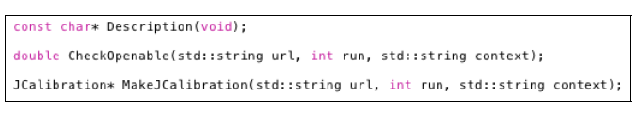
JANA interface
Two main parts:
1) JCalibrationGenerator A generator class (e.g. JCalibrationGeneratorMySQL)
2) Jcalibration class implementing the backend itself.
Retrieve calibration constants from CCDB (GetCalib())
Insert calibration constants into CCDB (PutCalib())
Discovery of available constants (GetListOfNamepaths())
Identication of event-level boundaries (RetrieveEventBoundaries())
Framework accepts connection strings:
“mysql://halld user@halld db.jlab.org”

Slide 6
Table structure
If we have tables lets present it as tables
double | int | string| double | string| double | double | double | int | double
We may handle it like table
ColumnInfo | ColumnInfo | ColumnInfo| ColumnInfo| ColumnInfo
DataRow
DataCell
DataCell
DataCell
DataCell
DataCell
DataRow
DataCell
DataCell
DataCell
DataCell
DataCell
Table *table = db->GetTable(“path/to/data”)
table->GetColumnInfo(0);
table->GetColumnsCount(); table->GetRowsCount();
table->BlobGenerate(IntVal(2), DoubleVal(1.223), StringVal(“my string”))
RowsCollection *rows = db->ParseBlob(blob)
Derived classes may be easily autogenerated and work without performance loose
Works together with Type-specific accessor functions

Slide 7
Auto generation
We may autogenerate such thing
X | Y | Z | Iter | comment
DataRow
double
double
double
int
String
DataRow
double
double
double
int
string
UserTable * table = dynamic_cast< UserTable *>db->GetTable(“path/to/data”)
UserRow *row= table->GetRow(0);
row->X();
row->Y();
…
row->Comment();
Since UserRow has autogenerated members like int fX
Using a row->X(); will NOT be a performance loose on
Some things like virtual tables etc..

Slide 8
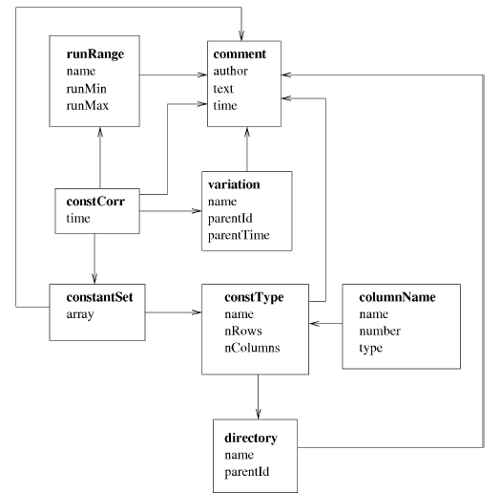
DB Structure

Slide 9
Overall design
Interfaces
WEB
Console
Tools
JANA and C++ Users
Python USERS
PHP
Calib. DB API
C++
Python API
MySQL Provider
File DB Provider
My SQL Server
Local DB File

Slide 10
Interaction with other languages
JANA uses CCDB C++ API
Possible C++ user may use CCDB C++ API without JANA?
Web interface uses PHP wich interacts to MySQL (or Posgres or whatever) through queries or stored procedures.
Console interface uses CCDB C++ API. Maybe is written on Python.
Python is using CCDB C++ API.
Other possible languages may use CCDB C++ API or MySQL Queries (or stored procedures)

