Slide 1
Discussion on console tools for CCDB
Dmitry Romanov
November 02, 2010

Slide 2
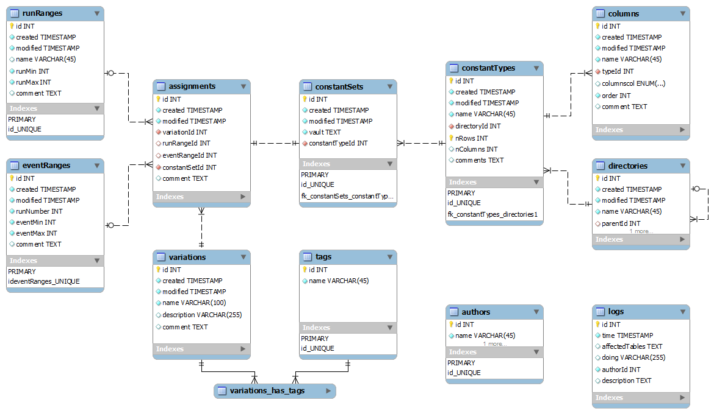
DB structure update

Slide 3
Overall design
Interfaces
WEB
Console
Tools
JANA and C++ Users
Python USERS
PHP
Calib. DB API
C++
Python API
MySQL Provider
File DB Provider
My SQL Server
Local DB File

Slide 4
Console tools
Make it as much simple as it could be with best learning curve
If it have directories and names like POSIX file system, let looks like POSIX file system. ls, rm, mkdir, mv etc. commands
Interactive mode
/> ls
adc/ dca/
> cd adc
adc > ls
adc _pedestals adc_scales
adc>ls –a
adc _pedestals : 3 variations, 5 versions … <full info>
adc>dump adc _pedestals --run 1200 --variation mc > /home/user/pedestals.txt
Command line mode
ccdb <connection> dump /adc/adcpedestals --run 1200 --variation mc > /home/user/pedestals.txt

Slide 5
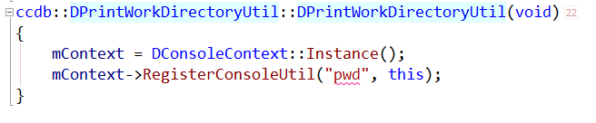
Implementation
Interactive mode
DConsoleContext
MySQL Provider
Streams
Commad parser
Utils by command
DHelpUtil
/> ls --all_tree
DPrintWorkDirUtil
Command line mode
ccdb <connection> ls --all_tree
DPrintWorkDirUtil
--all_tree
DConsoleContext – singleton model
All utils are derived from DConsoleUtilBase
Each utility has instance that calls RegisterConsoleUtil()
Each utility have to implement GetHelp() …. functions
Thus we get very flexable plugin like system
DListObjectsUtil
. . .

Slide 6
Privileges
We have two modes
Read mode
Update mode
Read mode doesn’t require any passwords
Update mode require password, and user name.
Each DConsoleUtil may ask DConsoleContext for update mode (like rm, mkdir, mv etc. functions), DConsoleContext will ask user for password and login
How to store “update” password???

Slide 7
LOGS
Each database update is logged
User names are trusted

