Slide 1
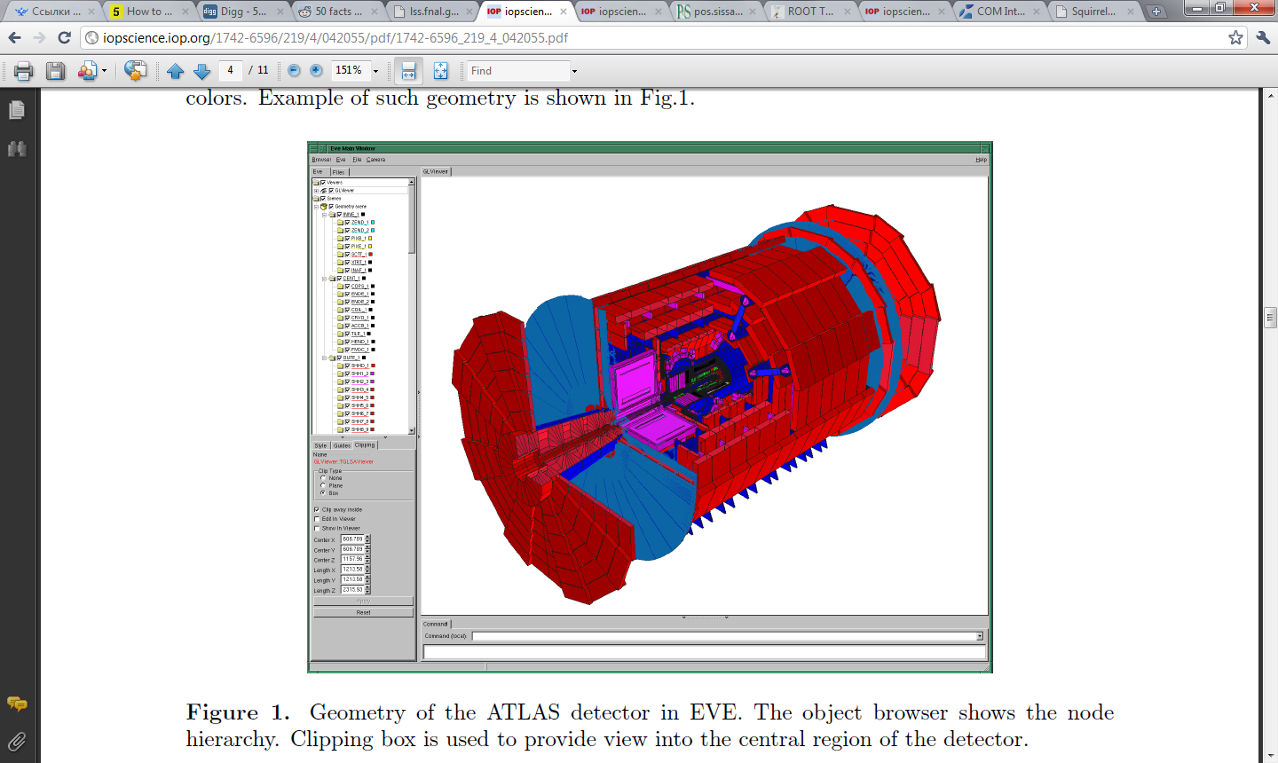
Root based event display
Dmitry Romanov
October 19, 2010

Slide 2
EVE - ROOT
Some experiments using EVE
History
2005 - Design beginning
2007 - In December, EVE was introduced into ROOT as a standard module.
2008 - EVE reached maturity (end of API changing)
2009 - 2010 – extensions and optimizations
ALICE
CMS
FAIR
NA-62
T2K
ILD in ILC

Slide 3
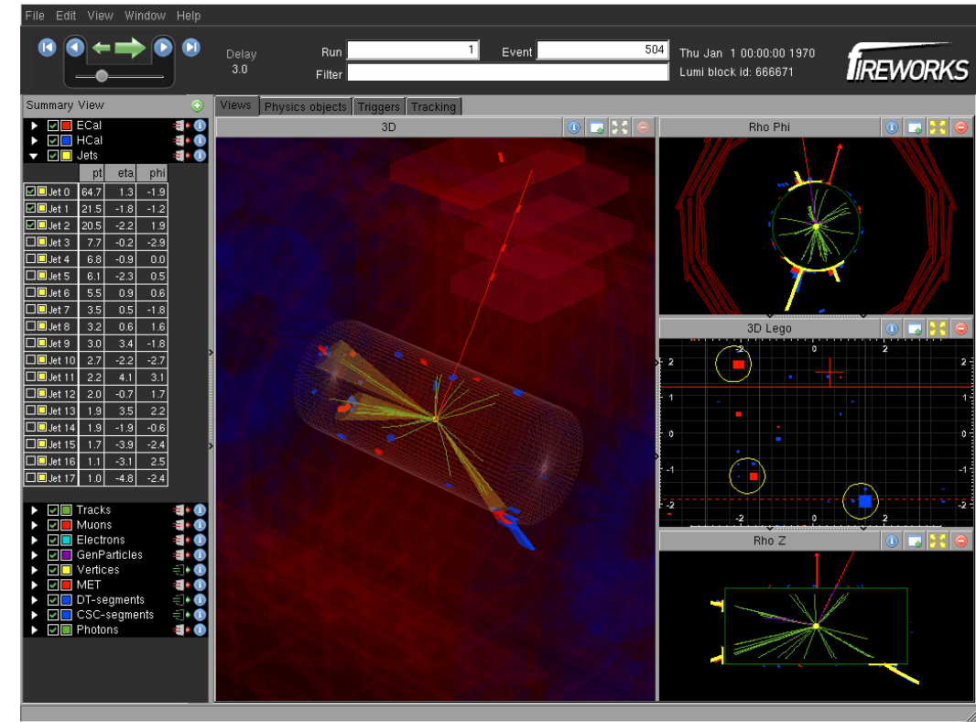
FIREWORKS CMS Event Display

Slide 4
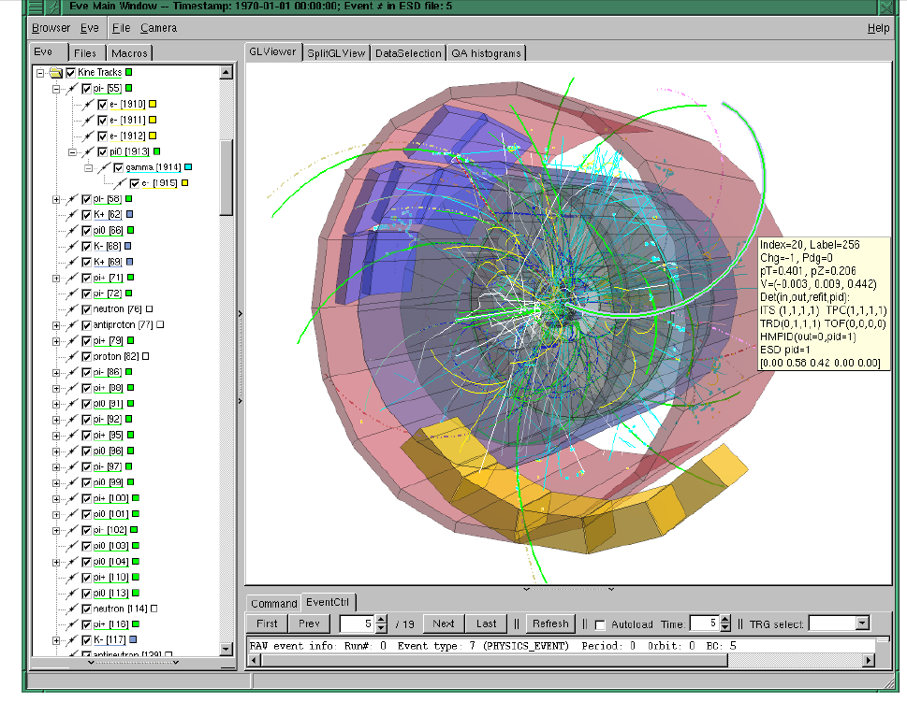
ALICE event display

Slide 5
Contains
Management of object-browsers, 3D scenes and 3D viewers;
Management of ROOT GUI windows in arbitrary congurations of tabs, stacks and main-frames;
Registration of visualization objects;
Selection management;
Data-base of visualization parameters that can be assigned to elements based on their type (a string tag);
Event management & navigation;
Execution environment for CINT scripts.

Slide 6
Event Visualization Environment I.
Requirements – what to display:
Geometry, simulation & reconstruction data
Raw-data
Top-level trigger events and monitoring data
On-line detector monitoring data
Allow progressive introduction of functionality:
simple things must be simple, complicated possible.
Implementation – how to do it:
EVE – extendible framework, not a monolithic application
Build on top of ROOT: GUI, OpenGL for 3D graphics
Use same philosophy: modular, loosely coupled class toolbox
Provide new elements as needed:
  Put basic / low-level development back into ROOT
  Build composite / top-level elements from those

Slide 7
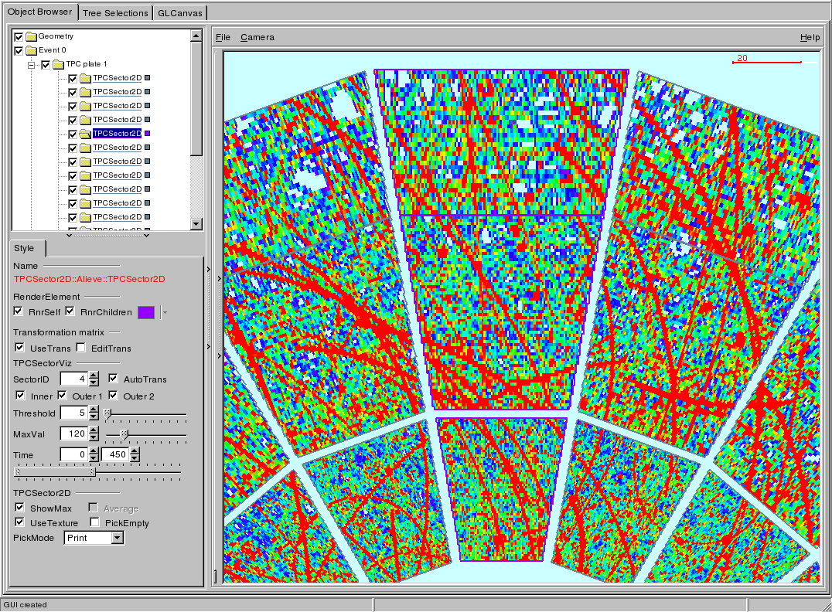
Object list
OpenGL viewer
Object editor

Slide 8
Standard visualization classes
Geometry:
  Direct usage via TGeoPainter: requires geometry
  Extracted shape-data: standalone, fully configurable
Hits, clusters:
  PointSet: per-point TRef (optionally owned by the object)
    Special TSelector provided for filling - use Tree machinery
  PointSetArray: an array of point-sets - interactive histogram
    Select on external criteria provided during filling
Trajectories, particles, tracks:
  Track: supports extrapolation in (const) magnetic field
  Can specify position/momentum at:
    arbitrary reference points (enter/leave certain volume)
    daughter creation points / momentum
    decay points
  TrackList – an array of tracks
    Interactive selection on standard track parameters: pT, chi2, …

Slide 9
Geometry
ROOT includes a native geometrical modeler, TGeo, that provides methods for construction of detector geometries, particle tracking and volume visualization via the class TGeoPainter. In EVE, display of full TGeo geometries is provided via a wrapper-class TEveGeoTopNode.

Slide 10
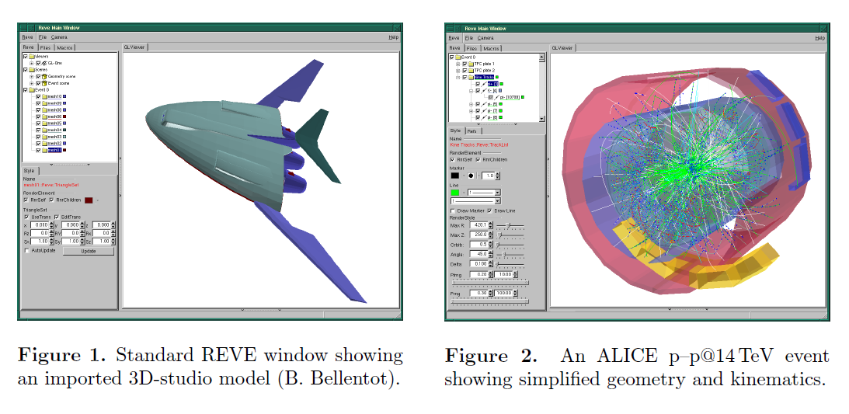
Custom geometry objects

Slide 11
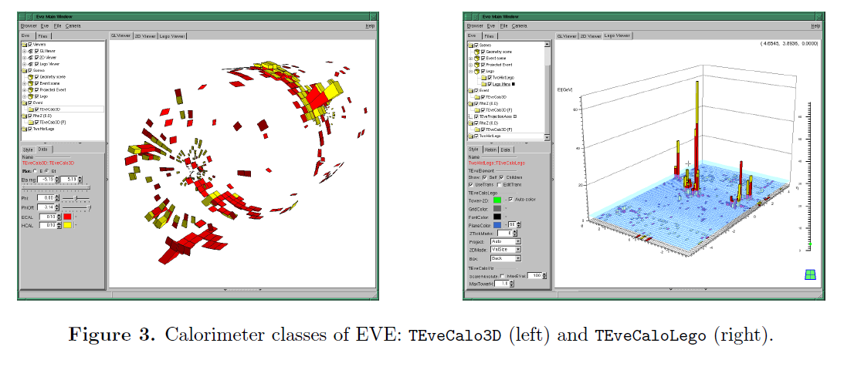
Calorimetry
Calorimeter classes in EVE can be divided into two categories: the data holding classes and the visualization classes.

Slide 12
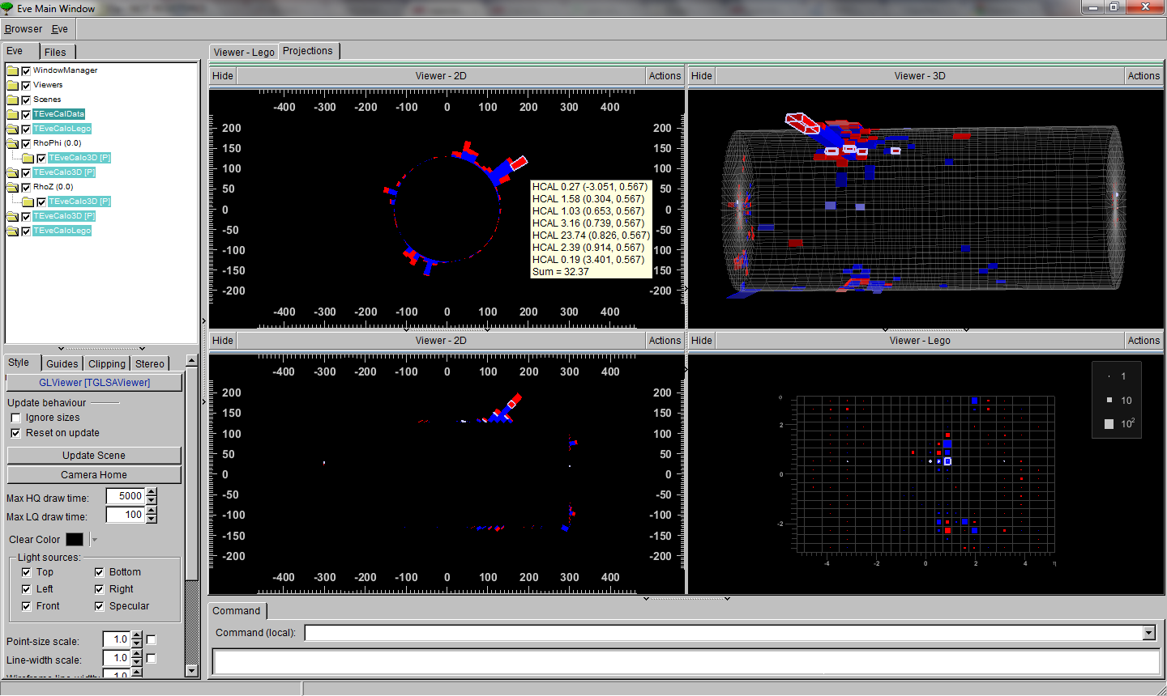
Calorimetry

Slide 13
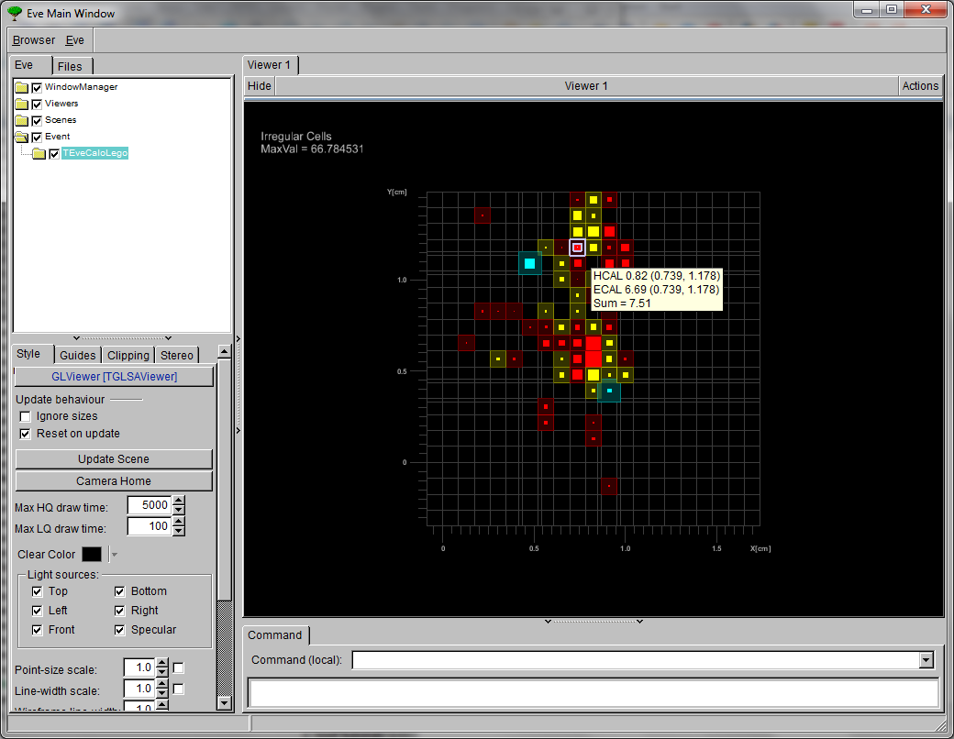

Slide 14
movie alieve-pmd.swf

Slide 15
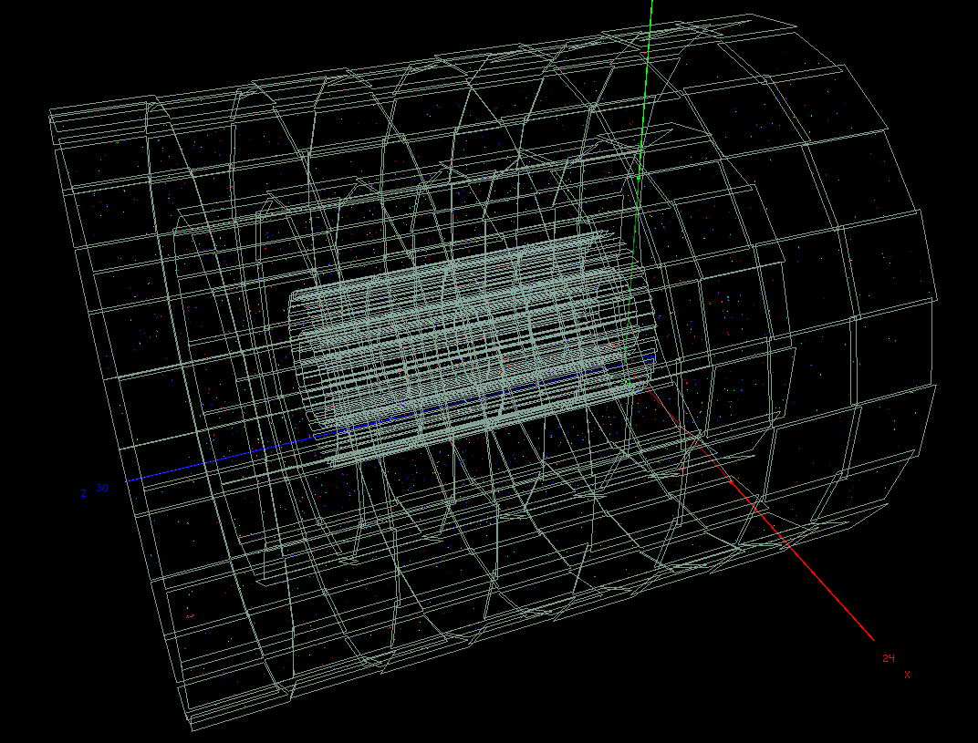
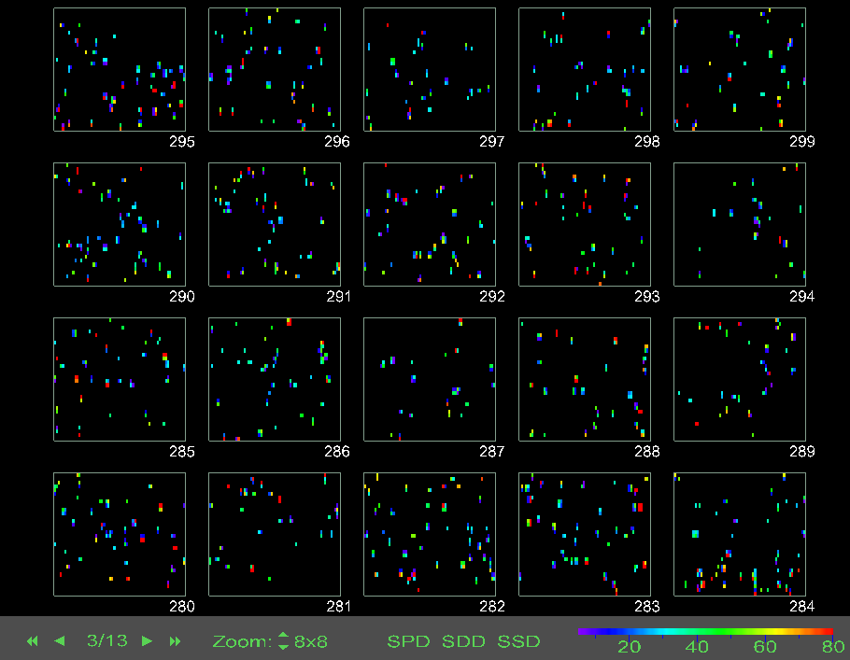
Intermediate-level raw-data inspection
Two common problems:
  detectors hide each other
  individual digit is too small
  3D view nonsensical ...
I. 2D multi-paged arrangement
  View as many modules as possible
  Arrange them in pages
  Provide selection (by type, phi, eta, ...)
  2D multi-paged arrangement
II. Digit scaling
  Accumulate nearby digits.
  Show statistical quantities for group:
  average, RMS
  occupancy
  min / max values

Slide 16
What is root and what is not?
ALICE Event display structure
Two main modules:
  Reve/ ROOT only,
    Application core
    Framework base-classes for GUI and VIZ
    Basic visualization classes (points, tracks, raw-base, …)
      All with GUI editors and GL renderers!
  Alieve/ AliROOT
    Event loading / navigation
    Classes for detector-module representation (raw-data)
    CINT scripts that perform data extraction
Application core:
  Management of browsers and viewers
  Registration of visualization objects (global / event)
  Execution environment for CINT scripts
  Event management & navigation

Slide 17
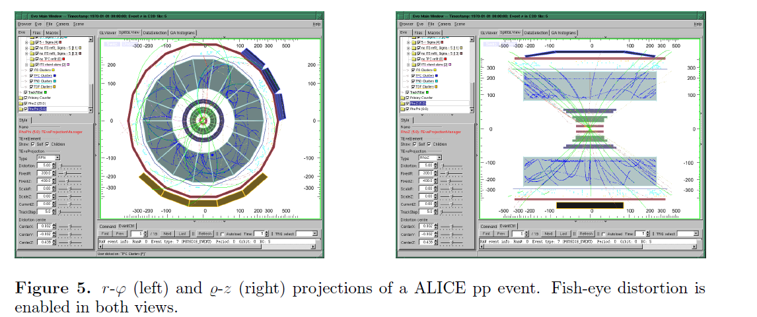
Visual reconstruction validation
Detailed view of reconstruction
Primary vertex, tracks, clusters
Backward navigation to simulation data
Counting of primary tracks on initial data-sample:
cross-check pT and eta distributions against std reconstruction

Slide 18
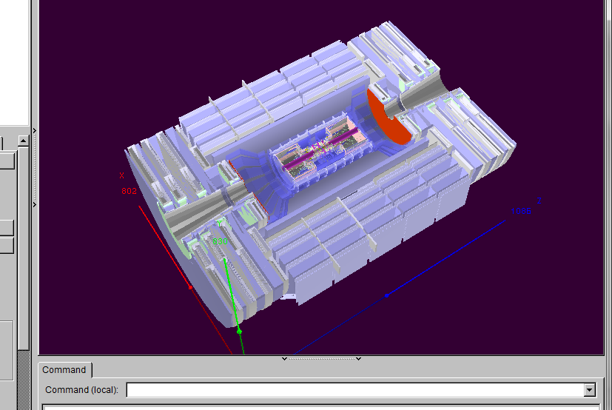
To try it
Eve examples could be found in
$ROOTSYS/tutorials/eve

Slide 19
Database progress
MySQL structure - done
Data model C++ representation – done
Data model operations (providers) – MySQL mostly done
JANA integration -in progress
Command line tools -in progress
WEB representation
Python integration
C++ API
Updates and bug hunting
Unclear
File storage and DB storage conversion
File storage formats

